Slide 1
ENGINEERING ETHICS & ATTITUDE Lecture 6. MORAL PROBLEMS RELATED TO SUSTAINABLE DEVELOPMENT - ROLE & DEVELOPMENT OF CODES OF CONDUCT FOR CIVIL ENGINEERS
Dr. András Timár
professor emeritus
University of Pécs, Hungary
Faculty of Engineering and Information Technology
2016

Slide 2
SUSTAINABLE DEVELOPMENT 1
Sustainable development is economic & social development that meets the needs of the present without compromising the ability of future generations to meet their own needs
Sustainability is a requirement of our genera-tion to manage non-renewable natural resour-ces in such a way, that the average quality of life that we ensure ourselves can potentially be shared by all future generations
Development is sustainable if it involves a non-decreasing average quality of life and protects the environment on the Earth

Slide 3
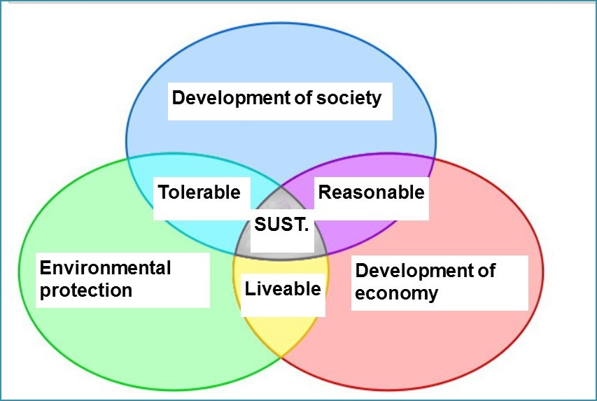
SUSTAINABLE DEVELOPMENT 2
Scheme of sustainable development: at the confluence of three constituent parts

Slide 4
SUSTAINABLE DEVELOPMENT 3
Consumption of renewable resources | Condition of the environment | Sustainability
More than nature is able to reproduce | Environment is destroyed | Not sustainable
Equal to the capacity of nature to reproduce | Environment is in balance | Sustainable but unchanging (steady state)
Less than nature is able to reproduce | Environment is renewing | Sustainable development

Slide 5
SUSTAINABLE DEVELOPMENT 4
Sustainability, does not have an intrinsic meaning: in a simplistic sense it merely means the capacity to keep doing something
Sustainable development has been described in terms of three spheres, dimensions, domains or pillars, i.e. the environment, economy and society; culture as a fourth pillar has been defined recently by UN (2011)
All pillars and their inter-relationships have to be considered and assessed when development strategies, programs, or projects are prepared
In design and construction engineers share the responsibility for the co-ordination and harmonisation of the conflicting objectives

Slide 6
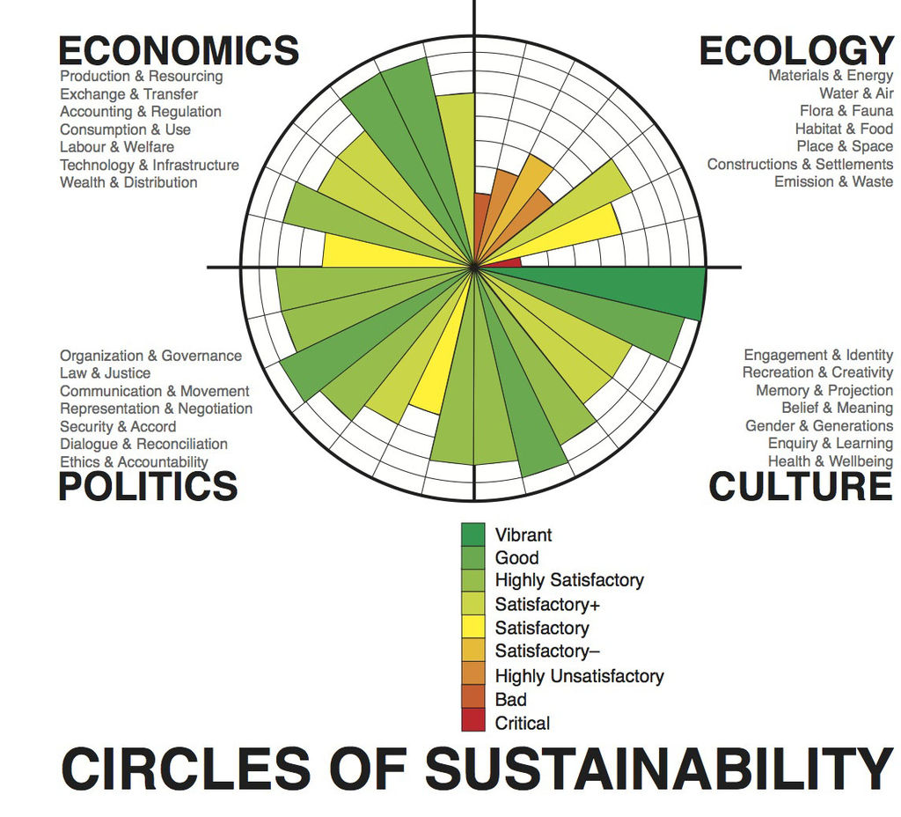
SUSTAINABLE DEVELOPMENT 5
Sustainable development progress according to the Circles of Sustainability (UN)

Slide 7
SUSTAINABLE DEVELOPMENT 6
Definition by the American Society of Civil Engineers (ASCE, 2009.):
Sustainable Development is the process of applying natural, human, and economic resources to enhance the safety, welfare, and quality of life for all of the society while maintaining the availability of the remaining natural resources.

Slide 8
ETHICAL APPROACH
The sustainability framework extends ethical concern to future generations, because traditionally we have obligations only towards currently living creatures
Sustainability challenges present day humans (among them engineers) to consider the well-being of future generations, to view their needs as worthy of our moral concern
Sustainability is not an absolute condition, but always partial; it occurs along a conti-nuum, and making progress along this is necessarily incremental - restraint is its price

Slide 9
ENGINEER’S ACTIVITIES 1
Activities of engineers have also non-technical (environmental, economic, social and moral) aspects and impacts
Engineers are not only creating things by developing, designing and implementing technologies, but knowingly choosing moral values, therefore influencing society
Majority of engineers today is engaged by complex corporative entities as employee or manager, facing conflicts of interest
(e. g. loyalty vs. honesty or fairness)

Slide 10
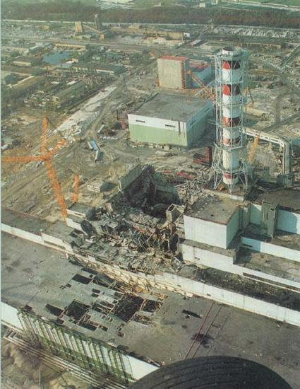
ENGINEER’S ACTIVITIES 2
Serial crises experienced in the modern era have changed our traditional relation to technology (i. e. „scientists discover new products and methods, engineers create, industry produces, while we easily using them”)
Seeing damages caused by serious natural and technical disasters, or negligence of environmental protection remain unrepaired, or irreparable, public opinion became more and more critical and sceptical towards technical development, outstan-ding knowledge and professionalism (populism)
An engineer's inherent interaction with society and societal needs leads naturally to her/his professional and moral responsibility to society

Slide 11
ENGINEER’S ACTIVITIES 3
This critical attitude of the public must encourage engineers to extend their activities beyond boundaries (in the narrow sense) of the development and implementation of technology
Besides the products and services created and provided, an engineer should consider also their relationships to and interactions with actual social, political, economic and environmental conditions
During her/his creative activities an engineer integrates various technical, economic, social and environmental components into a complex system, accepting moral responsibility

Slide 12
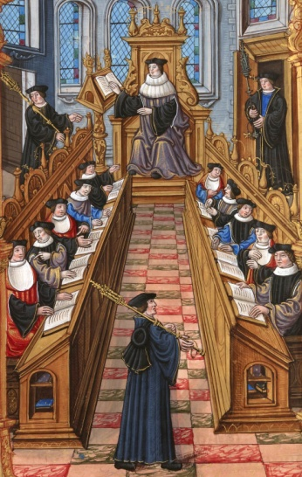
CHANGING ROLES
Due to competing, or mutually excluding expecta-tions about the future, the future itself becomes highly uncertain, i. e. not only events could not be forseen, but there are serious differences between opinions about their features and impacts as well
In democracies with functioning market economies highly educated people has no moral obligation any more to be involved into politics or become the „engine” of economic and social development
Universities all around the world are transformed into „knowledge factories”, engaging employees instead of „glasshouse scientists” contemplating and commenting social and economic events

Slide 13
ENGINEERING & ASSOCIATONS OF ENGINEERS
As engineering emerged as a distinct profession during the 19th century, engineers saw themselves as either independent professional practitioners or technical employees of large enterprises
There was considerable tension between the two sides as large industrial employers fought to maintain control of their employees
In the United States growing professionalism gave rise to the development of engineering societies: first among them was the American Society of Civil Engineers (ASCE) in 1851

Slide 14
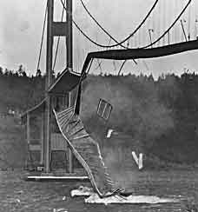
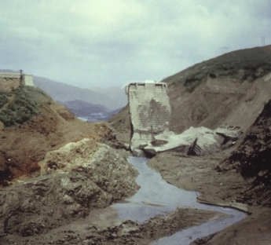
CODES OF ETHICS
At the beginning of the 20th century significant technical and design process failures lead to the collapse of huge engineering structures in the USA
These events had a profound effect on engineers and forced the profession to confront shortcomings in design and construction practice, as well as ethical standards
One response was the development of formal codes of ethics or codes of conduct by the engineering societies; ASCE adopted its own Code in 1914
Codes of engineering ethics identify a specific precedence with respect to the engineer's consideration for the public, clients, employers, and the profession

Slide 15
FROM PASSIVE TO ACTIVE BEHAVIOUR
The general principles of the codes of ethics are largely similar across the various engineering societies and chartering authorities of the world
Early codes of ethics for engineers emphasised the technical employees’ nearly unconditional loyalty towards their employers and profession („honor among thieves”)
The scope of ethical problems referred to in the Code of Conduct for Engineers has been extended in the 2nd half of the 20th century: clauses requiring active prevention of unethical behaviour were added to those providing guidance how to tackle moral dilemmas encountered

Slide 16
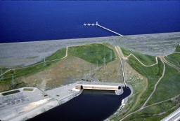
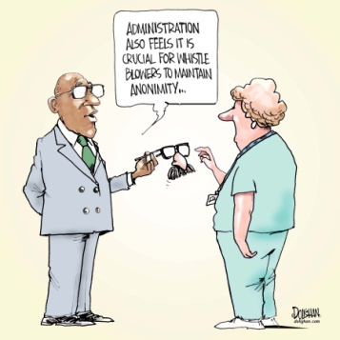
LOYALTY ABOVE ALL?
The Code of Conduct for Engi-neers could be used (unethically) to defend the company’s interest againts the public interest
A basic ethical dilemma is that an engineer has the duty to report to the appropriate authority a pos-sible risk to others from a client or employer and this duty over-rides the duty to a client and/or employer
Later on the protection of whistle-blowers appeared in the legisla-tion and companies also created their own Code of Conduct
Several enterprises apply so-called „hotline” allowing anonimity to employees reporting ethical anomalies by phone or mail
EXAMPLE 9.
Californian dam builders’ bribery
Making reference to their activities being non-compliant with the Code of Conduct, two civil engineers have been sent off by a construction company and expelled from the American Association of Civil Engineers in 1934, because they openly criticized the circumstances under which a huge dam has been built by their company near Los Angeles in the previous years.
A detailed study carryed out by a team of independent engineers and civil servants appointed by the State authorities following the engineers’ signal, discovered, that their remarks were presumably well founded, since a high ranking quality controller (member of the District Supervisory Board) has been involved into a serious scandal (accepting bribes – among others - from the construction company), and has been fired as a consequence.
The construction company was obliged to pay back to the Client $500 000 as penalty for its wrongdoing and immoral behaviour. Despite these facts, the chief engineer of the construction company has never been impeached and referring to their lack of loyalty towards the employer the two engineers were never re-integrated into the construction company

Slide 17
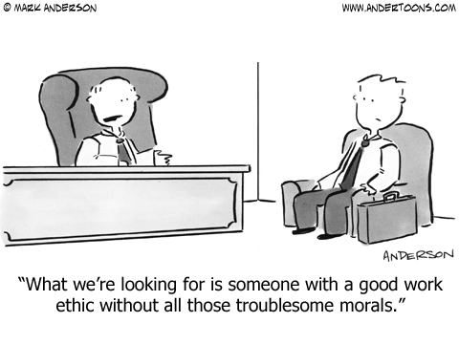
AT THE HR DEPARTMENT

Slide 18
FUNDAMENTAL PRINCIPLES
Engineers shall hold paramount the safety, health and welfare of the public and shall strive to comply with the principles of sustainable development in the performance of their professional duties
Engineers shall perform services only in areas of their competence
Engineers shall issue public statements only in an objective and truthful manner
Engineers shall act in professional matters for each employer or client as faithful agents or trustees, and shall avoid conflicts of interest
Engineers shall build their professional reputation on the merit of their services and shall not compete unfairly with others
Engineers shall act in such a manner as to uphold and enhance the honor, integrity, and dignity of the engineering profession and shall act with zero-tolerance for bribery, fraud, and corruption
Engineers shall continue their professional development throughout their careers, and shall provide opportunities for the professional development of those engineers under their supervision
The ASCE Code of Ethics (1914), (1968)

Slide 19
ACCURACY AND RIGOUR
1. Professional engineers and technicians have a duty to ensure that they acquire and use wisely and faithfully the knowledge that is relevant to the engineering skills needed in their work in the service of others. They should:
always act with care and competence
perform services only in areas of current competence
keep their knowledge and skills up to date and assist the
development of engineering knowledge and skills in others
not knowingly mislead or allow others to be misled about
engineering matters
present and review engineering evidence, theory and
interpretation honestly, accurately and without bias
identify and evaluate and, where possible, quantify risks
Statement of Ethical Principles for the Engineering Profession (UK, 2014)

Slide 20
HONESTY AND INTEGRITY
2. Professional engineers and technicians should adopt the highest standards of professional conduct, openness, fairness and honesty. They should:
be alert to the ways in which their work might affect others and duly respect the rights and reputations of other parties
avoid deceptive acts, take steps to prevent corrupt practices or professional misconduct, and declare conflicts of interest
reject bribery or improper influence
act for each employer or client in a reliable and trustworthy manner
Statement of Ethical Principles for the Engineering Profession (UK, 2014)

Slide 21
RESPECT FOR LIFE, LAW AND THE PUBLIC GOOD
3. Professional engineers and technicians should give due weight to all relevant law, facts and published guidance, and the wider public interest. They should:
ensure that all work is lawful and justified
minimise and justify any adverse effect on society or on the natural environment for their own and succeeding generations
take due account of the limited availability of natural and human resources
hold paramount the health and safety of others
act honourably, responsibly and lawfully and uphold
Statement of Ethical Principles for the Engineering Profession (UK, 2014)

Slide 22
RESPONSIBLE LEADERSHIP: LISTENING AND INFORMING
4. Professional engineers and technicians should aspire to high standards of leadership in the exploitation and management of technology. They hold a privileged and trusted position in society, and are expected to demonstrate that they are seeking to serve wider society and to be sensitive to public concerns. They should:
be aware of the issues that engineering and technology raise for society, and listen to the aspirations and concerns of others
actively promote public awareness and understanding of the impact and benefits of engineering achievements
be objective and truthful in any statement made in their professional capacity
Statement of Ethical Principles for the Engineering Profession (UK, 2014)

Slide 23
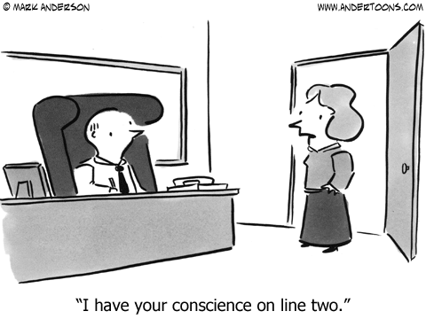
RESPONSIBLE LEADERSHIP?

Slide 24
CODE OF CONDUCT OF ECCE
Code of Professional Conduct of the European Council of Civil Engineers
Preamble
The purpose of Civil Engineering is to improve living conditions for mankind, always safeguarding life, health and property
A Civil Engineer is a servant of society and a promoter of culture and quality of life
A Civil Engineer must survey and analyse the demands of the present and anticipate future developments
A Civil Engineer should treat this Code actively as a set of dynamic principles
http://www.ecceengineers.eu/about/code_of_conduct.php

Slide 25
VIOLATION OF THE CODE
Any violation of the rules laid down in the Code of Ethics for Engineers, by technical employees represents a breach of the obligations ensuing from the employment relationship, with all contractual and legal consequences, and may be regarded as a breach of discipline
Leadership of professional associations and enterprises are responsible for the actual enforcement of the Code and its circulation among interested people
Professional associations are electing an independent body (ethical committee) being in charge of monitoring compliance with the Code of Ethics and dealing with eventual complaints

Slide 26
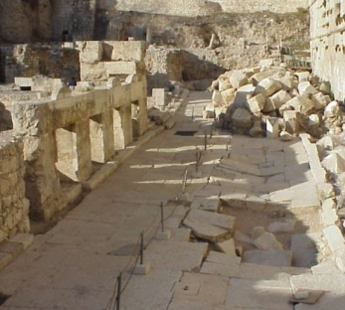
REMEDY HAS NO PRICE
Where and when
honesty/integrity, ethics or honour runs out
There and then comes the
law, politics and violence
Rules, regulations, directives and standards are changing, but „the stone remains”
To err is human, therefore engineers must do their best to repair as soon as possible all damages caused by alleged ethical misconduct, disregarding the costs and loss of reputation this may cause to them personally or to their company

Slide 27
SANCTIONS
In the event of a proven violation of the Code of Ethics, the appropriate Ethical Committee of a professional association shall take disciplinary measures against the person(s) responsible for the violation, which may consist in
issuing a warning (public or internal, oral or written)
levying a fine
temporary or final interdiction of holding office in the professional association
temporary suspension of membership in the professional association
exclusion from the professional association and
eventual prohibition from professional activities

Slide 28
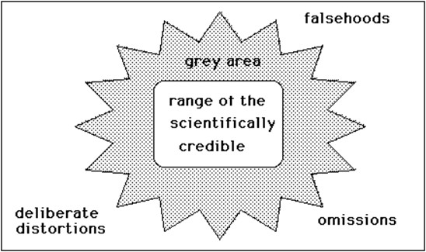
Engineers, Ethics and Sustainable Development
Value Judgements in Scientific Studies

Slide 29
Engineers, Ethics and Sustainable Development
Modern engineering codes of ethics require engineers to put the public interest before professional interests and business interests.
It is unrealistic to expect engineers to manifest higher ethical conduct than is the norm throughout the community in which they live.
Sustainable development sometimes seems to be inadequate to the solution of modern environmental problems.

Slide 30
REFERENCES
Code of Professional Conduct of the European Council of Civil Engineers (ECCE)
http://www.ecceengineers.eu/about/code_of_conduct.php
Code of Ethics of the American Society of Civil Engineers (ASCE)
http://www.asce.org/code-of-ethics/
Sharon Beder. 'Engineers, Ethics and Sustainable Development', Paper presented to the 10th International Congress of Logic, Methodology and Philosophy of Science, Florence, 1995.
https://www.uow.edu.au/~sharonb/esd/Florencetalk-2.html

Slide 31
THANK YOU VERY MUCH FOR YOUR KIND ATTENTION!

