Slide 1
Project management introduction
Beáta Neidert, Tibor Varga, Imre Szanyi, Timea Zengő

Slide 2
Agenda
01 | Introduction
02 | Vasa project
03 | Project management history
04 | ITIL
05 | Project
06 | Management
07 | Project Management
08 | Project vs Operation
09 | Project Program Portfolio
10 | PM Methods
11 | PM/PMO roles
12 | Project/Product life cycle

Slide 3
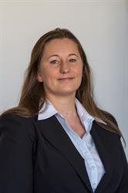




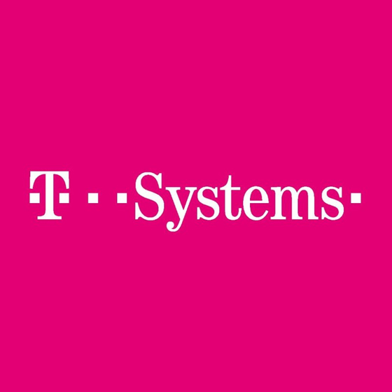

Introduction
Timea Zengő
Experience:
  Elcoteq 1999 – 2008
  Ericsson 2008 – 2015
  ITSH 2015 - present
Qualifications:
  2017 T-systems internal PM certification
  2016 ITIL Foundation IT Service Management
  2015 Shell License to Operate
  2015 PMI PMP Certification
  2004 Information technology engineer / University of Pécs

Slide 4
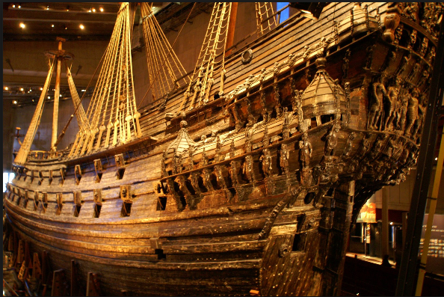
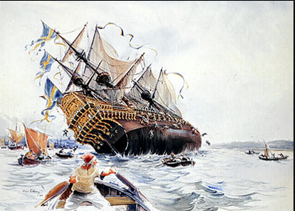
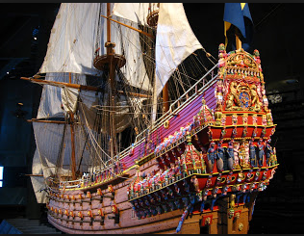
Vasa Warship Story– Stockholm - 1628
Notes:
The Vasa was a Swedish warship that was built during the early part of the 17 ^{th} century.
The construction of this warship was commissioned by the King of Sweden, Gustav II Adolf, who wanted to increase the military might of his country.
The construction has been started at 1625 and finished in 1628. On the 10 ^{th} of August 1628, the Vasa started on her maiden voyage. 1300 m later, the wind hit her side and due to instabality the ship, she fell over. As the gun-ports were left open, water starts flowing in, and within minutes, the Vasa had gone 32 m below the water.
I raise the question and would like to get ansers and explanation behind the anwser.
Was this project successful or not? What do you think?
Since projects are temporary in nature, the success of the project should be measured in terms of completing the project within the constraints of scope, time, cost, quality, resources, and risk as approved between the project managers and senior management.
What is the message of this story for us?

Slide 5
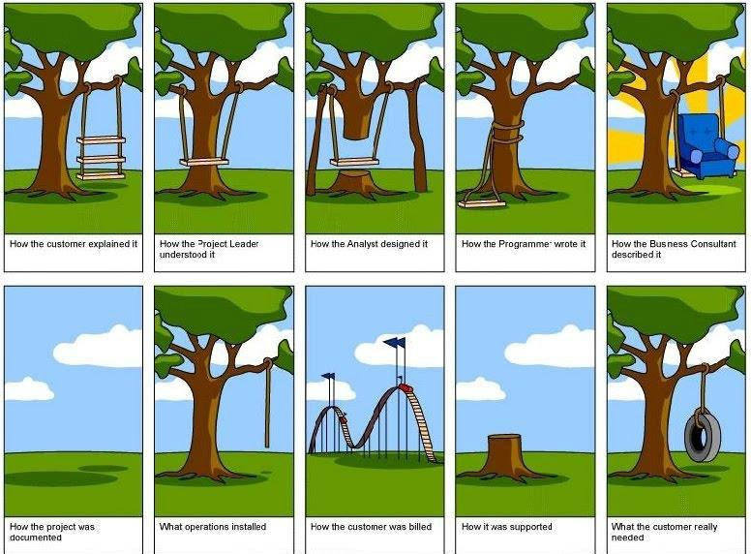
Project - different point of views
Notes:
swing

Slide 6
Project management history
Project management is the practice of initiating, planning, executing, controlling, and closing the work of a team to achieve specific goals and meet specific success criteria at the specified time.
Notes:
What is exactly project management?

Slide 7


Project management history
Notes:
How long has project management been around? Forever. Well, as long as people have been around.
The pharaohs built the pyramids of Egypt around 2500 BC, and to this day we aren’t certain how they accomplished such as big task. But records do show that there were managers, even back then, who were responsible for each of the four faces of the Great Pyramid.
In 208 BC the Great Wall of China was constructed, but there are records that indicate the planning went back even further. Historical data reveals that the workforce for this large project was organized into groups. There were three that we know of: soldiers, common people and criminals. Millions were ordered to complete the project.

Slide 8
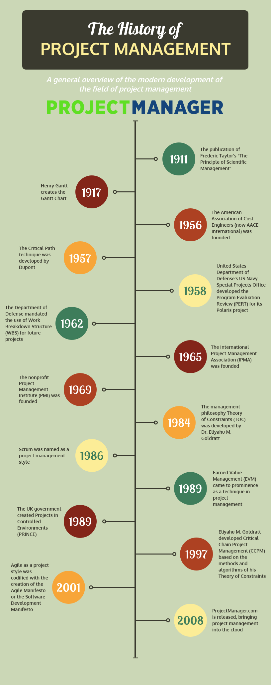
Project management history
Projects have been planned ever since people carry out larger tasks together.
The 1950s marked the beginning of the modern project management where core engineering fields come together to work as one.
In 1965 Project Management Association (IPMA) was founded (Western Europe)
In 1969 Project Management Institute (PMI) was founded (USA)
In 1989 Projects in Controlled Environments (PRINCE) was founded (UK)
Notes:
Picture: https://www.projectmanager.com/blog/history-project-management
https://en.wikipedia.org/wiki/Project_management
Until 1900, civil engineering projects were generally managed by creative architects, engineers, and master builders themselves, for example, In the 1950s organizations started to systematically apply project-management tools and techniques to complex engineering projects.
In the United States, prior to the 1950s, projects were managed on an ad-hoc basis, using mostly Gantt charts and informal techniques and tools. At that time, two mathematical project-scheduling models were developed. The "critical path method" (CPM) was developed as a joint venture between DuPont Corporation and Remington Rand Corporation for managing plant maintenance projects.
The "program evaluation and review technique" (PERT), was developed by the U.S. Navy Special Projects Office as part of the Polaris missilesubmarine program.

Slide 9
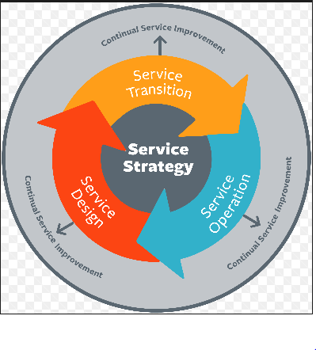
ITIL - Information Technology Infrastructure Library
ITIL is a library of volumes describing a framework of best practices for delivering IT services. Currently comprises five books, each covering various processes and stages of the IT service lifecycle.
Notes:
ITIL (formerly an acronym for Information Technology Infrastructure Library) is a set of detailed practices for IT service management (ITSM) that focuses on aligning IT services with the needs of business. ITIL is published as a series of five core volumes, each of which covers a different ITSM lifecycle stage. ITIL framework.
ITIL describes processes, procedures, tasks, and checklists which are not organization-specific or technology-specific, but can be applied by an organization for establishing integration with the organization's strategy, delivering value, and maintaining a minimum level of competency. It allows the organization to establish a baseline from which it can plan, implement, and measure. It is used to demonstrate compliance and to measure improvement. There is no formal independent third party compliance assessment available for ITIL compliance in an organisation. Certification in ITIL is only available to individuals and relates to their knowledge of the five books.
https://www.cio.com/article/2439501/itil/infrastructure-it-infrastructure-library-itil-definition-and-solutions.html
The IT Infrastructure Library (ITIL) is a library of volumes describing a framework of best practices for delivering IT services. The ITIL has gone through several revisions in its history and currently comprises five books, each covering various processes and stages of the IT service lifecycle.
Service Strategy
Service Design
Service Transition
Service Operation
Continual Service Improvement
ITIL Service Strategy:
Helps businesses develop organizational goals and objectives to prioritize customer needs.
Strategy management for IT services
Service portfolio management
Financial management for IT services
Demand management
Business relationship management
ITIL Service Design:
Offers a strategy to build a plan to deliver on established business objectives using RACI matrix, which stands for responsible, accountable, consulted and informed.
Design Coordination
Service catalogue management
Service-level management
Capacity management
IT service continuity management
Security management
Supplier management
ITIL Service Transition:
Focuses on the project development and operational use of services, setting it apart from day-to-day IT maintenance.
Transition planning and support
Change management
Service asset and configuration management
Release and deployment management
Service validation and testing
Change evaluation
Knowledge management
ITIL Service Operation:
Offers best practices for meeting service expectations with end-users, balancing cost and finding any problems. This volume is broken into two sections – process and functions, each with their own subcategories.
Processes
Event management
Access management
Request fulfilment
Problem management
Incident management
Functions
Service desk
Technical management
Application management
IT Operations management
ITIL Continual Service Improvement:
achieves services incremental and large-scale improvements using a seven-step process. The seven steps include:
Identify the strategy for improvement
Define what you will measure
Gather the data
Process the data
Analyze the information and data
Present and use the information
Implement improvement

Slide 10
project
Temporary endeavor (definite beginning and end)
Creating unique product, service or result for a purpose
Project constraints:
    scope of work, quality, budget, resources, schedule, risks, customer satisfaction
Notes:
Properties of project
New house, new type of care, new tpye of package for mobile service provider, study about life of birds

Slide 11
management
Strategic management involves the formulation and implementation of the major goals and initiatives taken by an organization's top management on behalf of owners, based on consideration of resources and an assessment of the internal and external environments in which the organization operates
Operations management is responsible for overseeing, directing, and controlling business operations. Operations evolve to support the day-to-day business, and are necessary to achieve strategic and tactical goals of the business.

Slide 12

project management
Application of knowledge, skills, tools and techniques to project activities to meet the project requirements
Goal oriented
Notes:
Deliver the pre-defined scope in time, within the agreed cost in a good quality.

Slide 13
project vs operation
Project | Operation
Creating new product/service/result | Repetitive product/service
Pre-defined start and end date | Continuous activity
Comprehensive knowledge is required | Specific knowledge
Temporally team | Permanent team
Unique | Repetitive and well-known

Slide 14
project vs operation
Project | Operation
Terv szerint dolgozók meghatározott költséggel. | Éves költségterv alapján dolgozik.
Megszüntetik, ha az előzetes célok nem teljesülnek. | A folyamatos működés majdnem minden körülmény ellenére biztosítva van.
Nehéz meghatározni és betartani a költségét és befejezésének idejét. | Az éves kiadások a korábbi tapasztalatok alapján kerülnek meghatározásra.

Slide 15
Project – Program- Portfolio
PORTFOLIO
Portfolio
PROGRAM
Program
Program
PROJECT
Project
Project
Project
Project
Notes:
The relationship among portfolios, programs, and projects is such that a portfolio refers to a collection of projects, programs, subportfolios, and operations managed as a group to achieve strategic objectives. Programs are grouped within a portfolio and are comprised of subprograms, projects, or other work that are managed in a coordinated fashion in support of the portfolio. Individual projects that are either within or outside of a program are still considered part of a portfolio. Although the projects or programs within the portfolio may not necessarily be interdependent or directly related, they are linked to the organization’s strategic plan by means of the organization’s portfolio.

Slide 16
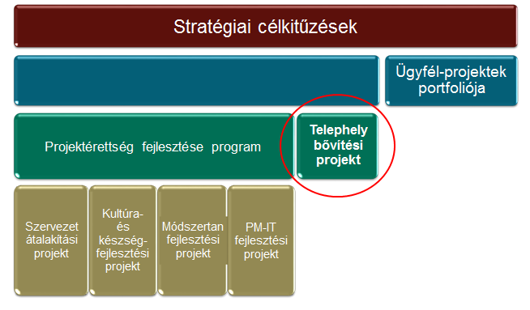
Project – Program- Portfolio

Slide 17
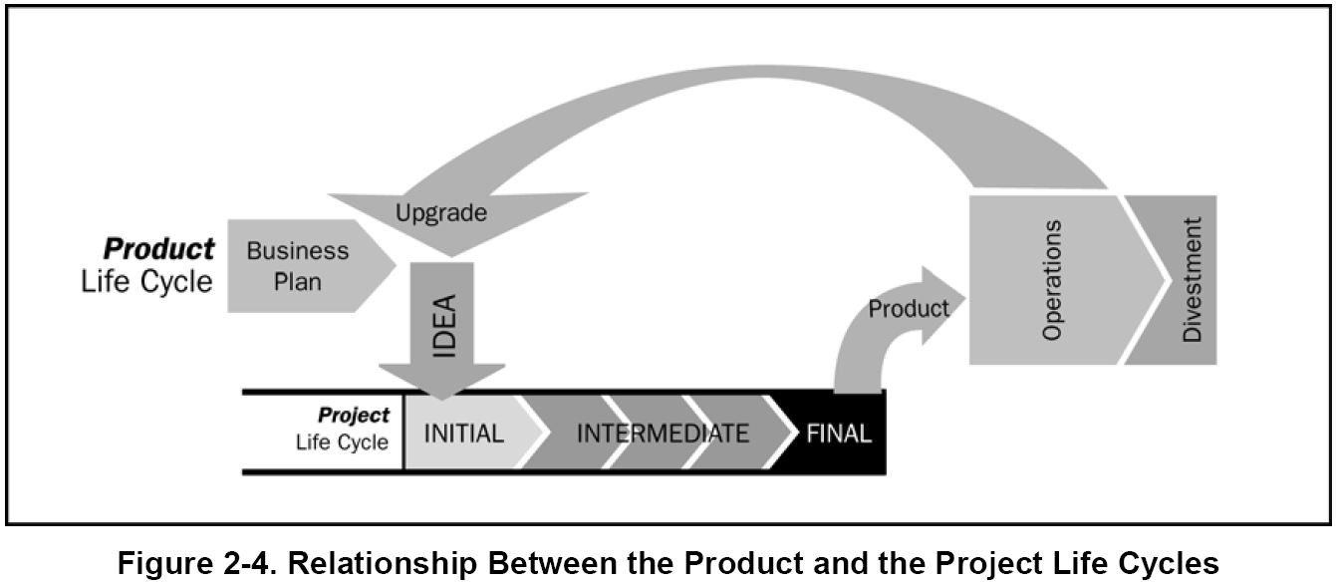
project life cycle / product life cycle
Notes:
Understand the differences!
The product life cycle is longer than the project life cycle.
The project life cycle has a definite end while the product life cycle may not.
A product life cycle can have single or multiple projects.
The product life cycle phases do not overlap while the project phases may overlap.
In the product life cycle phases are sequential, while in project life cycle phases may or may not be sequential.

Slide 18
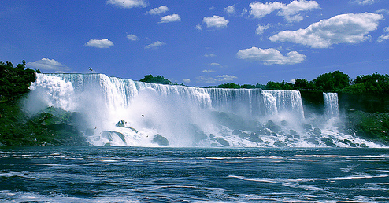
PROJECT MANAGEMENT methods
Waterfall Model
Iterative Model
Agile Model
Notes:
Iteratív modellek – 1980-as évek (melyekben a folyamatlépések nem lineárisan következnek egymás után, hanem a fázisok a fejlesztés előrehaladtával ismétlődnek)

Slide 19
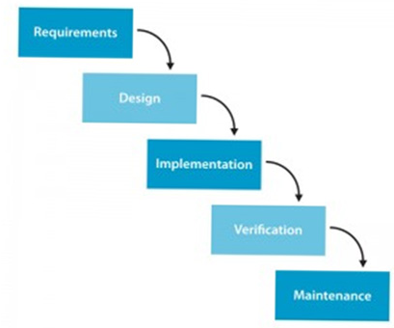
PM methods – Waterfall model
Detailed scoope at the beginning for the whole project ->
-> (master plan)
Change request after the master plan (smaller changes)
Notes:
The earliest use of the term "waterfall" may have been in a 1976 paper by Bell and Thayer.
The waterfall model is a relatively linear sequential design approach for certain areas of engineering design.
The waterfall development model originated in the manufacturing and construction industries.
The earliest use of the term "waterfall" may have been in a 1976 paper by Bell and Thayer.

Slide 20
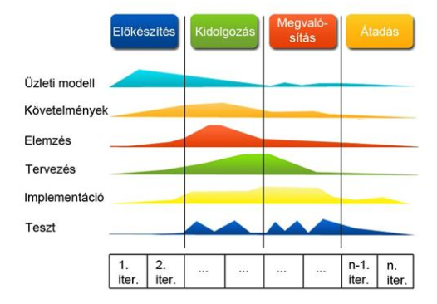
PM methods – Agile model
Do not have detailed scoope
Requirements list
Sprint (1,2…n)
Notes:
The development of agile modeling was led by Scott Ambler starting in the autumn of 2000.
The book Agile Modeling ^{[3]} was published in 2002 by John Wiley Press.
Agile modeling (AM) is a methodology for modeling and documenting software systems based on best practices. This methodology is more flexible than traditional modeling methods, making it a better fit in a fast changing environment.
Egy projekt általában egy ötlettel kezdődik.
Először elkezdik címszerűen összeírni, hogy mit is kell tartalmaznia a terméknek ahhoz, hogy az ötlet megvalósuljon ezt nevezzük product backlog listának.
A product owner vezetésével priorizálnak, majd ha elkezdik kidolgozni a mögöttes tartalmat is.
Ezt követően elkezdődnek az iterációk, amiket sprinteknek nevezünk.
A product owner és a fejlesztőcsapat a sprint elején összeül, és ennek a listának egy, a tetején lévő elemét, (amiről a product owner úgy gondolja, hogy belefér egy sprintbe) odaadja a csapatnak véleményezésre.
A lista elemeit (story) feladatokra (task) bontják, és ezeket a task-okat kivitelezik a fejlesztők, míg egy story el nem készül, majd folytatják a következő story-val a sprint backlog végéig.
Szintén fontos elem, hogy minden nap van egy úgynevezett daily scrum, amikor a team maga (az önszervezésből adódóan) megbeszéli, hogy mit csináltak az előző napon, hova jutottak, és az adott napon mivel folytatják.

Slide 21
project management roles – Project manager
Depends on the organizational structure, ultimate responsibility for the product quality of the project.
Knowledge (what the PM knows about project management)
Performance (what the PM is able to do or accomplish)
Personal (how the PM behaves when performing the project)
Notes:
Knowledge -> PM mit tud a PM managementről, erre nagyon jó támogató rendszerek vannak pár perc múlvamegnézzük részletessen a 10 tudásterületet, ami mentés, szerint dolgozunk
Performance -> hogy képes a tudása alapján végrhajtani, lemendzseni a projetet
Personal -> PM személyes attitüdjét jelenti, sokftskilleket (kommunikáció, stresszkezelés, érdekérvényesítő képesség, prezentációs technika, stb…) ezek fejleszthetők

Slide 22
project management roles – PMO
Organizational unit to centralize and coordinate management of projects (programs)
Levels of PMO:
Supportive: PM support function (templates, training, best practices, lessons learned, etc.)
Controlling: provides support and requires compliance (frameworks, methodologies, tools) – moderate control
Directive: direct management of and responsibility for projects

Slide 23
Organization structures
Functional
Hybrid
Project Matrix
  Weak
  Strong
  Balanced
Notes:
Project management success in an organization is highly dependent on an effective organizational communication style, especially in the face of globalization of the project management profession. Organizational communications capabilities have great influence on how projects are conducted.
Organizational structure is an enterprise environmental factor, which can affect the availability of resources and influence how projects are conducted. Organizational structures range from functional to
projectized, with a variety of matrix structures in between.

Slide 24










Organization structures - Functional
CEO
Engineering
Marketing
Manufacturing
Staff
Staff
Staff
Staff
Staff
Staff
Notes:
The classic functional organization, is a hierarchy where each employee has one clear superior. Staff members are grouped by specialty, such as production, marketing, engineering, and accounting at the top level. Specialties may be further subdivided into focused functional units, such as mechanical and electrical engineering. Each department in a functional organization will do its project work independently of other departments.
E forma popularitásának alapját az adja, hogy az egyik leggyakrabban alkalmazott szervezeti felépítésben, a lineáris-funkcionális szervezetben alkalmazható.
Munkamegosztás: elsődleges funkciók szerint, munkaköri leírás alapján
előfeltétele: stabil piac, nem túl széles termékskála, technológiai környezet.
előnye: munkafolyamat szabályozottsága jelentős -> koordinációs ktg. csökkenése, stratégiakialakítása egyszerű és olcsó a stabil környezet miatt
hátránya: adott esetben nehezen áttekinthető kapcsolatok, felesleges tartalék, megváltozott környezethez nem tud időben alkalmazkodni.
A projektszervezet ebben a megoldási formában középvezetői szinten ágyazódik be a szervezeti működésbe, vagyis a projektvezető ideiglenes középvezetőként funkcionál a szervezetben.
Minden résztvevő közvetlenül a projektmenedzser alá tartozik, akiknek ő utasítást adhat, illetve együttműködik az esetleges megrendelő képviselőjével, jelentést ad a projekt előrehaladtáról, riportál a felső vezetésnek vagy a tulajdonosoknak.
A projekt team elméletileg teljesen autonóm módon működik, ám ne feledjük, hogy a projektszervezetbe delegált funkcionális szakember esetében kialakulhat az úgynevezett kettős függőség helyzete, amikor a team tag egyszerre van alárendelve projektvezetőjének, illetve funkcionális vezetőjének.
Ahogy a projekt befejeződik, a teamnek és a menedzsernek további feladata nincs, a csapat feloszlik, a tagok visszatérnek eredeti beosztásukba.
Olyan vállalatok alkalmazzák, ahol a projektszerű működéssel bíró feladatok csak esetlegesen, különleges helyzetekben és ritkán jelennek meg. Ehhez a szervezet úgy alkalmazkodik, hogy eseti jelleggel, ideiglenesen hozza létre a projekt teamet.
Ez a tény egyben azt is jelzi, hogy stratégiai jellegű projekteknél nem alkalmazható ez a forma, hiszen ott a projektvezetésnek a vállalati felső vezetésben van a helye.

Slide 25
Organization structures - Hybrid
Project director
CEO
Engineering
Marketing
Manufacturing
Staff
Staff
Staff
Staff
Staff
Staff
Notes:
A vállalatok felső vezetése gyakran vegyest /hybrid szervezeti felépítést választ annak érdekében, hogy ne legyen szükség teljesen felborítani egy eseti projektfeladat megoldásának kedvéért a már jól bevált szervezeti formációt.
A szervezet működési jellemzői megegyeznek a funkcionálissal.
A projekt kvázi új funkcióként, a topmenedzsmenthez felső szinten (projektigazgató) közvetlenül kapcsolódva teljesen autonóm módon épül ki a szervezeten belül .
Ebben az esetben jelenik meg az a szervezeti jellegzetesség, hogy a vállalat teljes egészében megtarthatja eredeti – jelen esetben funkcionális – felépítési jellegét.
Ezt a szervezeti formát akkor érdemes választani, ha a felső vezetés kiemelt, stratégiai jelentőséget tulajdonít a projekt végrehajtásának, egyrészt azért, mert a projektvezetés közvetlenül alá van rendelve a topmenedzsmentnek, másrészt, mivel a projektmenedzser a stratégiai vezetéssel azonos hierarchiaszinten van.
Mindamellett egy új felső szintű vezető kinevezése ideiglenesen felboríthatja a szervezetben kialakult törékeny hatalmi egyensúlyt is.

Slide 26










Organization structures – weak matrix
CEO
Engineering
Marketing
Manufacturing
Staff
Staff
Staff
Expediter, Coordinator
Staff
Staff
Notes:
Matrix organizations, as shown in Figures 2-2 through 2-4, reflect a blend of functional and projectized characteristics. Matrix organizations can be classified as weak, balanced, or strong depending on the relative level of power and influence between functional and project managers.
Weak matrix organizations maintain many of the characteristics of a functional organization, and the role of the project manager is more of a coordinator or expediter. A project expediter works as staff assistant and communications coordinator. The expediter cannot personally make or enforce decisions.
A mátrix-szervezet elsõősorban a komplex és dinamikus külső - és belső környezet által kiváltott koordinációs, innovációs és adaptációs problémákra keres megoldást.
A projektmátrix olyan sajátos szervezeti megoldás, melyben a funkcionális egységek vezetőivel a projektmenedzserek teljesen egyenértékűek, velük azonos hierarchiaszinten helyezkednek el.
előnye: adaptív, innovatív, más struktúrában is létrehozható (mikromátrix), új vezetési kultúra kialakítását teszi lehetővé, tagokat nagyobb teljesítményre ösztönzi, erőforrások hatékonyabban vannak kihasználva
hátránya: vezetők rivalizálása, túlhajtott csoportmunka, döntések elhárítása, felelősségvállalástól való tartózkodás, összeomlás veszélye krízishelyzetben.
Weak jellemzői:
A projektmenedzser hatásköre, erőforrásokhoz való hozzáférése korlátozott, s ő, valamint az alárendeltjei is csak munkaidejük egy részét töltik a projekttel, addig a funkcionális vezető kezeli a költségvetést, nagy a funkcionális vezető befolyása.

Slide 27









Organization structures – strong matrix
CEO
Manager of PMs
Engineering
Marketing
Manufacturing
Staff
Staff
Staff
Project manager
Staff
Staff
Staff
Notes:
Strong matrix organizations have many of the characteristics of the projectized organization, and have full-time project managers with considerable authority and full-time project administrative staff.
Ellentétben a gyenge mátrixal, itt a a projektmenedzser pozíciója stabil és erős , ő kezeli a projektbüdzsét, így hatásköre szélesebb.
Minden a projektel kapcsolatos döntést a PM hoz meg a teamel közösen, függetlenül a funkcionális vezetőktől.
Emellett érezhető, hogy a projekt fontos a szervezet számára is, mivel a projektmenedzsmentnek csak a projektre kell összpontosítania munkája során.

Slide 28
Organization structures – Balanced matrix
CEO
Engineering
Marketing
Manufacturing
Staff
Staff
Staff
Project manager
Staff
Staff
Notes:
Balanced matrix organization recognizes the need for a project manager, it does not provide the project manager with the full authority over the project and project funding.
A kiegyensúlyozott projektmátrix (balanced projectmatrix) egyrészt a fenti két forma
átmeneteként definiálható,
másrészt az eltolódott hatalmi erőterű helyzetekkel szemben
a klasszikus mátrixszervezet vezérelvét követve közös megegyezéseken alapuló
projektvezetést követel meg a résztvevőktől, pl. a projektköltségvetés kezelésében

Slide 29
QUESTIONS?

