Slide 1
Project management
Project stakeholders, Phases
Timea Zengo

Slide 2
Agenda
01 | Knowledge areas
02 | Process groups
03 | Project phases vs. Process Groups
04 | Stakeholders
05 | Project team
06 | Organization structures
07 | House build -Example

Slide 3
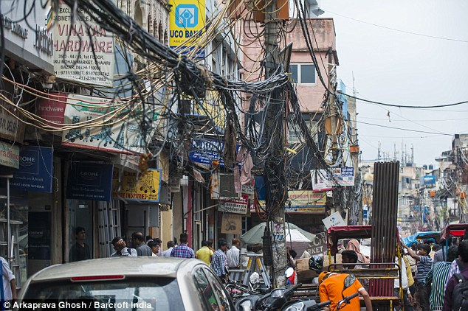
Why do we have to plan a project?

Slide 4
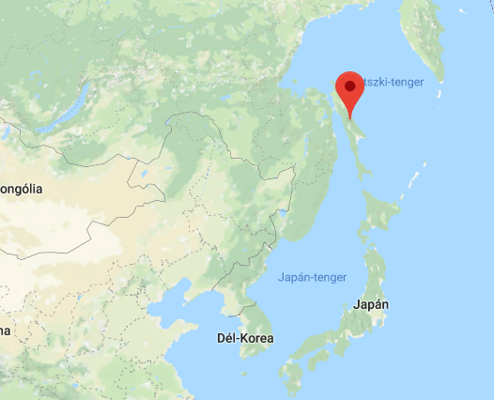
Shell story
Sakhalin izland
Inital cost:
20 billion $
Final cost:
40 billion $.
Shell introduced standard processes, methodologies, and reporting requirement.

Slide 5
project procesSES
Processes (47), process groups (5), knowledge areas (10)
Source: PMBOK Guide
 | Initiating | Planning | Executing | Controlling | Closing
Integration | Develop Project Charter | Develop Project Management Plan | Direct and Manage Project Work | Monitor and Control Project Work Perform Integrated Change Control | Close Project or Phase
Scope |  | Plan Scope Management Collect Requirements Define Scope Create WBS |  | Validate Scope Control Scope
Time |  | Plan Schedule Management Define Activities Sequence Activities Estimate Activity Resources Estimate Activity Durations Develop Schedule |  | Control Schedule
Cost |  | Plan Cost Management Estimate Costs Determine Budget |  | Control Costs
Quality |  | Plan Quality Management | Perform Quality Assurance | Control Quality
HR |  | Plan Human Resource Management | Acquire Project Team Develop Project Team Manage Project Team
Comm. |  | Plan Communications Management | Manage Communications | Control Communications
Risk |  | Plan Risk Management Identify Risks Perform Qualitative Risk Analysis Perform Quantitative Risk Analysis Plan Risk Responses |  | Control Risks
Proc. |  | Plan Procurement Management | Conduct Procurements | Control Procurements | Close Procurements
Stakeholder | Identify Stakeholders | Plan Stakeholder Management | Manage Stakeholder Engagement | Control Stakeholder Engagement

Slide 6
Process GroupS
• Initiating Process Group. Those processes performed to define a new project or a new phase of an existing project by obtaining authorization to start the project or phase.
• Planning Process Group. Those processes required to establish the scope of the project, refine the objectives, and define the course of action required to attain the objectives that the project was undertaken to achieve.
• Executing Process Group. Those processes performed to complete the work defined in the project management plan to satisfy the project specifications.
• Monitoring and Controlling Process Group. Those processes required to track, review, and regulate the progress and performance of the project; identify any areas in which changes to the plan are required; and initiate the corresponding changes.
• Closing Process Group. Those processes performed to finalize all activities across all Process Groups to formally close the project or phase.

Slide 7
Process groups
Planning
processes
Monitoring & Controlling
processes
Enter Phase / Start project
Initiating
processes
Closing
processes
Exit Phase /
End project
Executing
processes

Slide 8





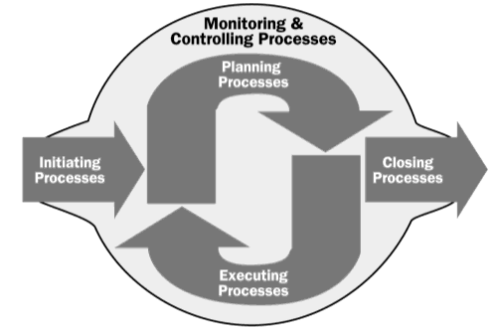

Project phase vs. Process Groups
Projectphases in IT development project
Specification
Develompment
Testing
Implementation
Support
Single-Phase project
House building

Slide 9
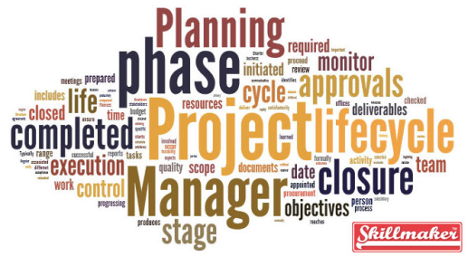
Project life Cycle
Project Life Cycle = Sequence of Project Phases
Project Phases: deliverables
(deliverables, decision at the end (review, phase exit, phase gate, kill point) e.g. Specification, Implementation, Testing, etc.)
Process Groups: managing project

Slide 10
project procesSES
Processes (47), process groups (5), knowledge areas (10)
Source: PMBOK Guide
 | Initiating | Planning | Executing | Controlling | Closing
Integration | Develop Project Charter | Develop Project Management Plan | Direct and Manage Project Work | Monitor and Control Project Work Perform Integrated Change Control | Close Project or Phase
Scope |  | Plan Scope Management Collect Requirements Define Scope Create WBS |  | Validate Scope Control Scope
Time |  | Plan Schedule Management Define Activities Sequence Activities Estimate Activity Resources Estimate Activity Durations Develop Schedule |  | Control Schedule
Cost |  | Plan Cost Management Estimate Costs Determine Budget |  | Control Costs
Quality |  | Plan Quality Management | Perform Quality Assurance | Control Quality
HR |  | Plan Human Resource Management | Acquire Project Team Develop Project Team Manage Project Team
Comm. |  | Plan Communications Management | Manage Communications | Control Communications
Risk |  | Plan Risk Management Identify Risks Perform Qualitative Risk Analysis Perform Quantitative Risk Analysis Plan Risk Responses |  | Control Risks
Proc. |  | Plan Procurement Management | Conduct Procurements | Control Procurements | Close Procurements
Stakeholder | Identify Stakeholders | Plan Stakeholder Management | Manage Stakeholder Engagement | Control Stakeholder Engagement

Slide 11

Integration Management
Project Integration Management includes the processes and activities to identify, define, combine, unify and coordinate the various processes and project management activities within the Project Management Process Groups.

Slide 12


Project Scope Management
Project Scope Management includes the processes required to ensure that the project includes all the work required, and only the work required, to complete the project successfully.

Slide 13

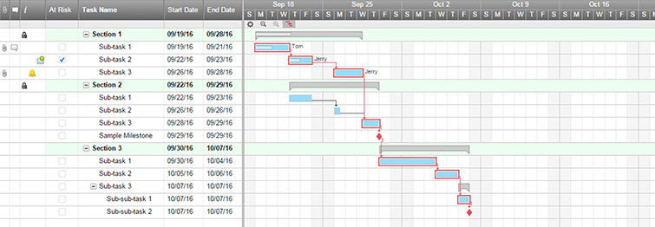
Project Time Management
Project Time Management includes the processes required to manage the timely completion of the project.

Slide 14
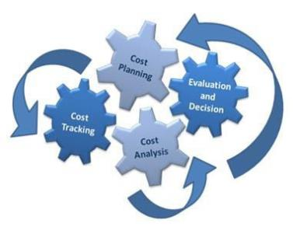
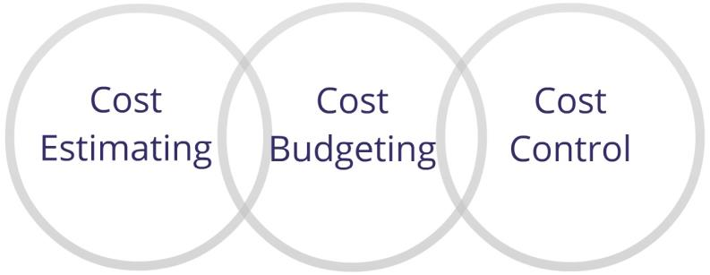
Project Cost Management
Project Cost Management includes the processes involved in planning, estimating, budgeting, financing, funding, managing, and controlling costs so that the project can be completed within the approved budget.

Slide 15


Project Quality Management
Project Quality Management includes the processes and activities of the performing organization that determine quality policies, objectives, and responsibilities so that the project will satisfy the needs for which it was undertaken.

Slide 16


Project Human Resource Management
Project Human Resource Management includes the processes that organize, manage, and lead the project team.
Notes:
The project team is comprised of the people with assigned roles and responsibilities for completing the
project. Project team members may have varied skill sets, may be assigned full or part-time, and may be added or
removed from the team as the project progresses. Project team members may also be referred to as the project’s
staff. Although specific roles and responsibilities for the project team members are assigned, the involvement of
all team members in project planning and decision making is beneficial. Participation of team members during
planning adds their expertise to the process and strengthens their commitment to the project.

Slide 17

Project Communication Management
Project Communications Management includes the processes that are required to ensure timely and appropriate planning, collection, creation, distribution, storage, retrieval, management, control, monitoring, and the ultimate disposition of project information.

Slide 18

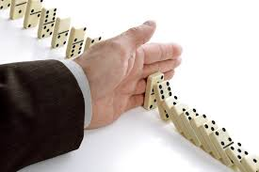
Project Risk Management
Project Risk Management includes the processes of conducting risk management planning, identification, analysis, response planning, and controlling risk on a project. The objectives of project risk management are to increase the likelihood and impact of positive events, and decrease the likelihood and impact of negative events in the project.

Slide 19
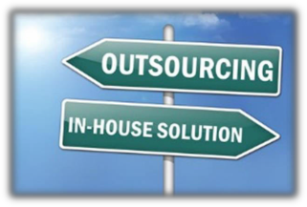

Project Procurement Management
Project Procurement Management includes the processes necessary to purchase or acquire products, services, or results needed from outside the project team.

Slide 20

Stakeholder management
Project Stakeholder Management includes the processes required to identify the people, groups, or organizations that could impact or be impacted by the project, to analyze stakeholder expectations and their impact on the project, and to develop appropriate management strategies for effectively engaging stakeholders in project decisions and execution.

Slide 21

Stakeholders
Who are actively involved in the project and/or
whose interests may be affected by the performance or completion of the project.

Slide 22

StakeholDers – main players
Customer
Project Sponsor
Project manager
Project team
Steering Commitee
Vendors
Other external members

Slide 23
Identify stakeholders
Project Stakeholders
Portfolio
Manager
Steering Commity
Sponsor
Functional Managers
Operations
Mgmt.
Program Manager
Project Team
Sellers/ Business Partners
Core team
Other Team
Project Manager
Members
PMO
Customers Users
The Project

Slide 24
Stakeholder analysis
Multiple classifications:
1. Power/interest grid
High
Keep Satisfied
Manage Closely
Power/influence grid
Influence/impact grid
Power
Monitor
Keep Informed
Low
Low
Interest
High

Slide 25







Stakeholder analysis - Example
CEO
Project manager
Sub-contractor
Head of finance
Head of HR
Real estate agency
Head of
development
High
1
4
2
5
Power
7
3
6
Low
Low
Interest
High

Slide 26
Steering Commitee
Project Steering Committee
ACR: Account Customer Responsible
CFR: Contract Fulfillment Responsible
CSR: Customer Solution Responsible
Project Sponsor
ACR
CFR
CSR
Project manager
Project team
Supplier

Slide 27
Stakeholders – Bóly FTTH & 3Play services

Slide 28
Project team - Bóly FTTH & 3Play services

Slide 29
QUESTIONS?

