Slide 1
STRATEGY & COMPANY CULTURE
Nóra Réti dr.

Slide 2
Strategy - history
What does it mean?
Stratos – army
Strategy – art of military leadership

Slide 3
Strategy/ Tactics/ Operations

Slide 4
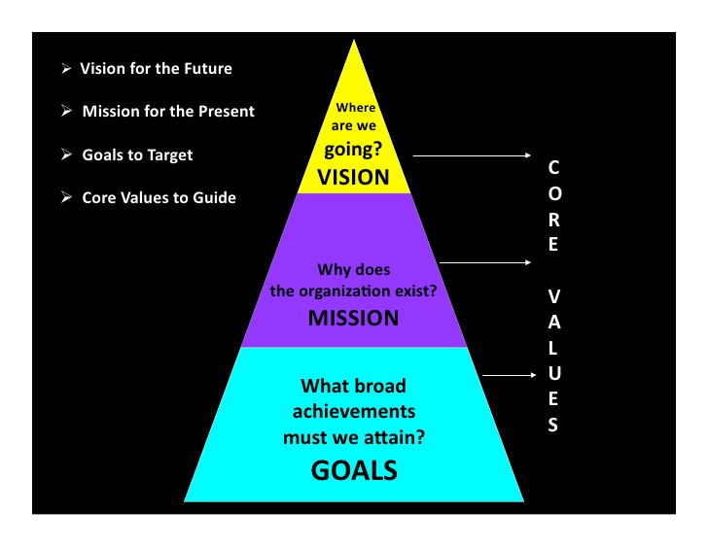
Vision, mission, goals, values

Slide 5
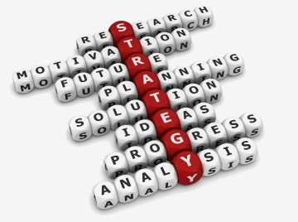
Five Essentials of an Effective Strategy
It is deeply understood and shared by the organization.
2. It allows flexibility, so that the direction of the organization can be adapted to changing circumstances.
3. It results from the varied input of a diverse group of thinkers.
4. It follows a thorough and deep analysis of both the external environment and the internal capabilities of the organization.
5. An effective strategy identifies areas of Competitive Advantage.

Slide 6
Strategy - planning
If you fail to plan you plan to fail
What is a strategic plan?
What is the current status?
Where do we go?
How can the goal be reached?
A strategic plan contains
Mission
Vision
Values
Strategic goals - SMART
Defined targets (financial or other)
Defined set of goals in hierarchy
Strategic actions
Detailed strategic plan, all strategy items linked to specific targets
Tools, deadlines, responsibles

Slide 7
SMART goals

Slide 8
External and internal enviroment analysis
External
Competitors
Suppliers
ROI
Customer requirements, replacement products
Social
Cultural
Technology
Economical
Political
Internal
Financial position/state
Financial efficiency
Research and Development (R&D)
Management
HR
Marketing
Resources
Competencies
Organization
Organizational structure
Company culture

Slide 9
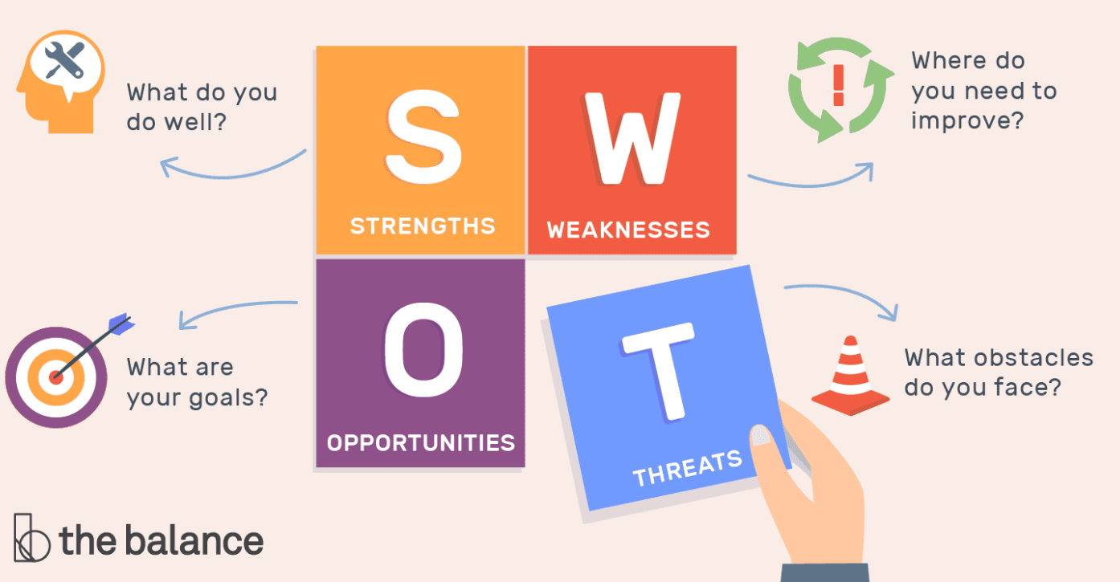
SWOT analyses

Slide 10
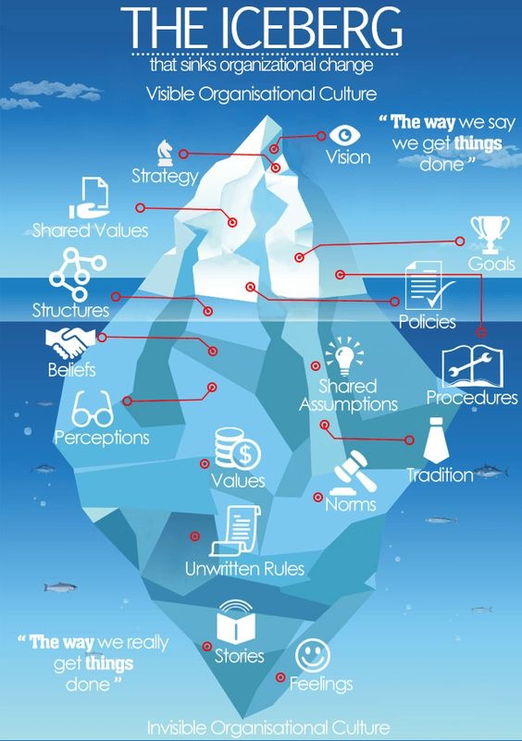
ORGANIZATIONAL CULTURE

Slide 11
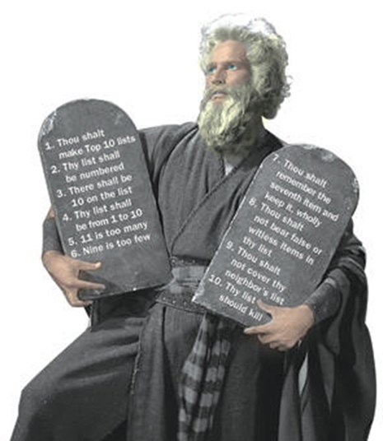
Guiding principles
A principle is a general belief about the way you should behave, which influences your behavior.
How to make them work:
Get clear it’s importance
Walk the talk
Make them public
Enforce them
House rules
Govern the actions
Guidelines
General
Common understanding
Essential parts of the company culture

Slide 12
GUIDING PRINCIPLES @ T-Systems
Customer delight and simplicity drive our action
Respect and integrity guide our behavior
Team together – Team apart
Best place to perform and grow
I am T – Count on me
Notes:
Customer delight and simplicity drive our action A vevői elégedettség és az egyszerűség irányítja tevékenységünket Beleképzelem magam az ügyfél helyébe Felülmúlom ügyfeleim elvárását Egyszerűbbé teszem a dolgokat Fejlődök és fejlesztek Jobb értékű szolgáltatást nyújtok, mint versenytársaim
Respect and integrity guide our behaviour A tisztelet és az integritás irányítja viselkedésünket Etikusan cselekszem és követem a törvényt Tisztelem és becsülöm mások egyéniségét Őszintén és nyitottan cselekszem Kivívom a kollégáim és az ügyfelek tiszteletét Nem tolerálom a helytelen és az etikátlan magatartást
Team together − team apart Csapatként, együtt képviseljük a céget Nyíltan megosztom a véleményemet és nézeteimet Kíváncsi vagyok mások véleményére Személyeskedés nélkül kezeljük a problémákat Teljes mértékben a csapat döntése mellett állok Teljes energiával a döntés végrehajtásán dolgozom
Best place to perform and grow Legjobb hely az alkotásra és a fejlődésre Magunkhoz vonzuk és megtartjuk a legjobb és leginkább hozzáértő embereket Olyan környezetet garantálunk, amiben az emberek fejlődhetnek Elkötelezettnek érzem magam a legjobb eredményeket elérésre Felelősséget vállalok a saját fejlődésemért Elismerjük és díjazzuk a magas teljesítményt
I am T − Count on me T vagyok – Bízz bennem A Deutsche Telekom büszke nagykövete vagyok Teljesítem, amit ígértem Vállalom a felelősséget azért, amit teszek Úgy szolgálom a kollégáimat, ahogyan az ügyfeleimet A One Company érdekeinek megfelelően cselekszem világszerte

Slide 13
Different company cultures
Vodafone
Slogan: Power to You
More Confidently Connected
Unmatched Customer Experience
Always Competitive Value
HP
Slogan: The HP way
We have trust and respect for individuals
We focus on a high level of achievement and contribution
We conduct our business with uncompromising integrity
We achieve our common objectives through teamwork
We encourage flexibility and innovation
TESCO
Slogan: Serving Britain's shoppers a little better every day.
No one tries harder for customers
We treat people how they want to be treated
Every little help makes a big difference
Notes:
Vodafone:
More Confidently Connected: Vodafone Hungary's network modernization was successfully completed last year which means that now we can provide more than 9,5 million Hungarians with 3G broadband mobile internet; hence our outdoor nation-wide coverage is 97,4%. It is our goal to provide extraordinary customer experience through our reliable and fast mobile internet service available virtually everywhere in the country.
Unmatched Customer Experience: all our colleagues consider meeting our customers' needs as a top priority and conduct their work accordingly. Our success in this area is best illustrated by the fact that in 2012 we have won the Award for Excellence in Customer Service for the third time in a row.
Always Competitive Value: it is our goal to become the service provider that offers the most to its customers. Apart from our main strategic directions, we want to further strengthen our team by attracting new, talented colleagues and by further improving our working conditions.
HP:
The HP Way (c. 1992)
We have trust and respect for individuals
We approach each situation with the belief that people want to do a good job and will do so, given the proper tools and support. We attract highly capable, diverse, innovative people and recognize their efforts and contributions to the company. HP people contribute enthusiastically and share in the success that they make possible.
We focus on a high level of achievement and contribution
Our customers expect HP products and services to be of the highest quality and to provide lasting value. To achieve this, all HP people, especially managers, must be leaders who generate enthusiasm and respond with extra effort to meet customer needs. Techniques and management practices which are effective today may be outdated in the future. For us to remain at the forefront in all our activities, people should always be looking for new and better ways to do their work.
We conduct our business with uncompromising integrity
We expect HP people to be open and honest in their dealings to earn the trust and loyalty of others. People at every level are expected to adhere to the highest standards of business ethics and must understand that anything less is unacceptable. As a practical matter, ethical conduct cannot be assured by written HP policies and codes; it must be an integral part of the organization, a deeply ingrained tradition that is passed from one generation of employees to another.
We achieve our common objectives through teamwork
We recognize that it is only through effective cooperation within and among organisations that we can achieve our goals. Our commitment is to work as a worldwide team to fulfill the expectations of our customers, shareholders and others who depend upon us. The benefits and obligations of doing business are shared among all HP people.
We encourage flexibility and innovation
We create an inclusive work environment which supports the diversity of our people and stimulates innovation. We strive for overall objectives which are clearly stated and agreed upon, and allow people flexibility in working toward goals in ways that they help determine are best for the organization. HP people should personally accept responsibility and be encouraged to upgrade their skills and capabilities through ongoing training and development. This is especially important in a technical business where the rate of progress is rapid and where people are expected to adapt to change.
https://www.tescoplc.com/about-us/core-purpose-and-values/
Core Purpose and Values
Our core purpose:
Serving Britain's shoppers a little better every day
Our business was built with a simple mission – to be the champion for customers, helping them to enjoy a better quality of life and an easier way of living. This hasn't changed. Customers want great products at great value which they can buy easily and it's our job to deliver this in the right way for them.
That's why we've chosen 'Serving Britain's shoppers a little better every day' as our new core purpose. As a business, serving customers is at the heart of everything we do – from colleagues in our stores to those of us in supporting roles.
In the UK, we serve some 66 shoppers every second, so it's our goal to ensure every one of those customers experiences just a little better service on each visit.
Our Values help us to understand how to put this into practice:
No one tries harder for customers
Understand customers
Be first to meet their needs
Act responsibly for our communities
Understanding people – customers, colleagues, communities – and what matters to them, and then trying to make those things better, is at the heart of Tesco. It's about listening to people and talking to them using all the tools at our disposal – from Clubcard data to social media – and then acting by changing and innovating to meet their needs.
We treat people how they want to be treated
Work as a team
Trust and respect each other
Listen, support and say thank you
Share knowledge and experience
We know that looking after our colleagues in a culture of trust and respect is essential to the success of Tesco. Where colleagues feel recognised and rewarded for the work they do together, where they have the opportunity to get on and where they are supported in their development as they move through their careers in the business – they in turn try their hardest for customers.
Every little help makes a big difference
Helping to reduce food waste globally and ensuring surplus food goes to those in need
Making it easier to live more healthily
Sourcing great quality, affordable and sustainable products
Making a positive contribution to the communities where we operate.
Every little help makes a big difference – it’s the value we live by to ensure we serve our customers, colleagues and their communities a little better every day. It really captures how, when we add up all the small things we do, Tesco can make a big difference to the issues customers, colleagues, communities and wider society care about.
It covers the little things we do every day as well as linking these things together to contribute to the bigger global initiatives in which we are involved. It helps us take the right actions to restore trust and transparency in our business.
Since we first introduced our Tesco Values more than a decade ago, they have become a vital part of our culture – and an essential underpinning of our growth and success. They ensure that every person at Tesco understands what is important – about how we work together as a team and how customers are at the centre of what we do. They are universal values, which have helped guide our people as Tesco has grown into new markets and new countries.
Share

Slide 14
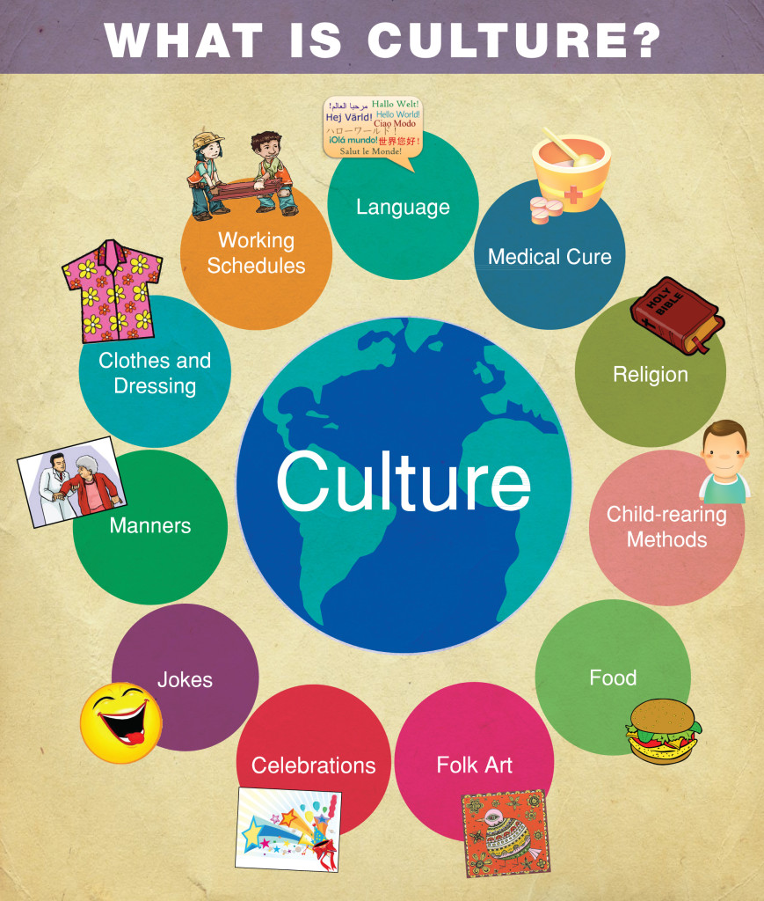
Cultural differences
Notes:
Magyar
Német
UK
Holland
Spanyol/Latin Amerika
Ázsia, India
Ausztrália

Slide 15
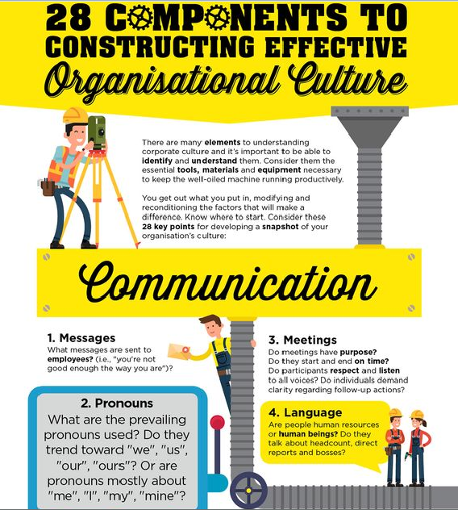

Slide 16
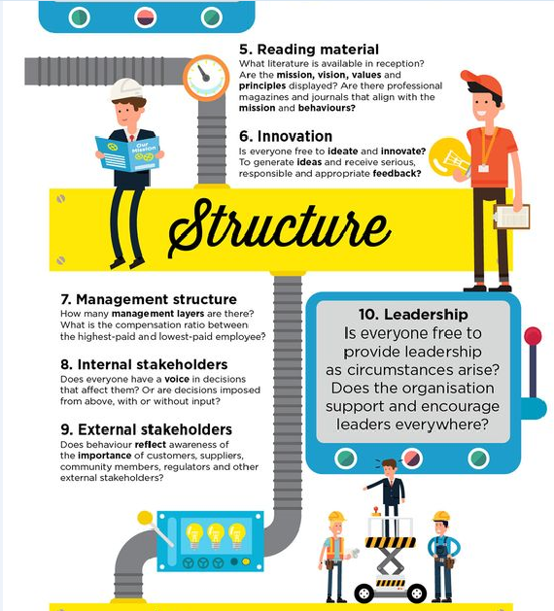

Slide 17
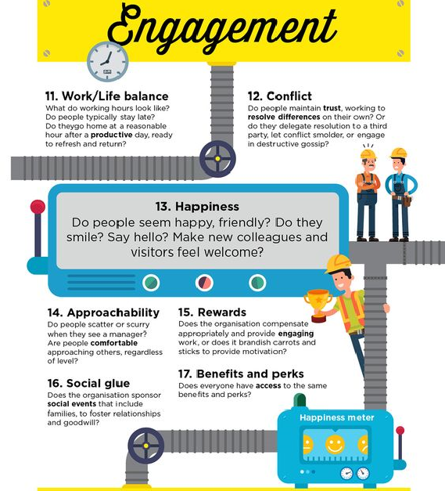

Slide 18
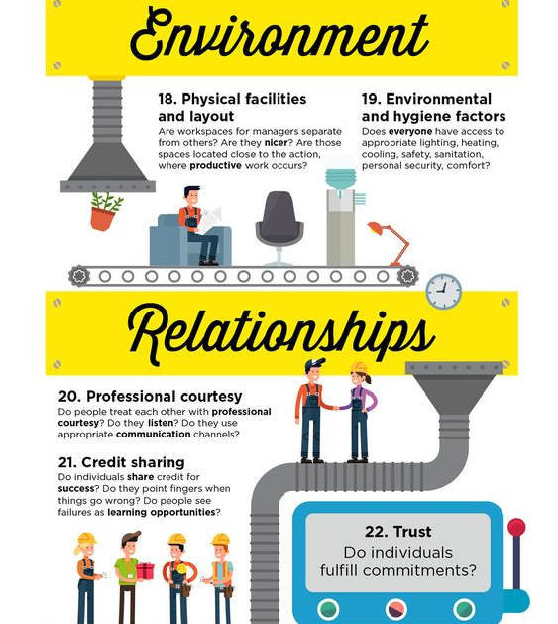

Slide 19
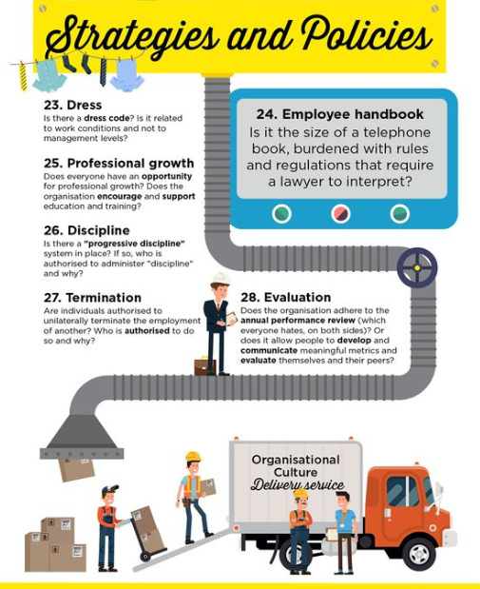

Slide 20
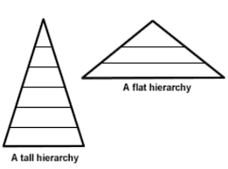
Impact on organizational structure
Flat organization vs hierarchical
A flat organization refers to an organization structure with few or no levels of management between management and staff level employees
A hierarchical organization follows the layout of a pyramid. Every employee in the organization, except one, usually the CEO, is subordinate to someone else within the organization

Slide 21
Differences between working for small vs. large companies
Getting the Job
Bureaucracy
Personal relationships
Flexibility
Carrier opportunities
Organizational changes
Better working conditions
A small business may have other priorities, (not just making money) like environmental or other social benefits
Job security, financial security

Slide 22
QUESTIONS?

