Slide 1
Project management 1 Project Initiation and Planning
Neidert Beáta, Varga Tibor

Slide 2
PROJECT Process Groups
Planning processes
Monitoring & Controlling processes
Enter Phase / Start project
Initiating processes
Closing processes
Exit Phase / End project
Executing processes

Slide 3
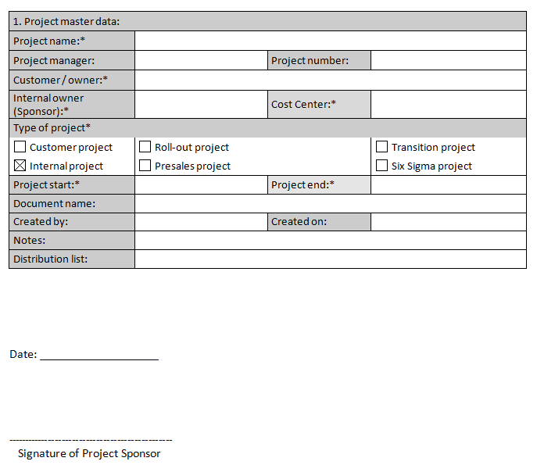
INITIATION
1. Initiation
2. Planning
3. Execution
4. Closing
Project Sponsor, Project manager
Project Charter
Timing
Roles
Stakeholders
Deliverables
Effects
Quality requirements of the result
MAIN INFORMATION, HIGH LEVEL PLANS

Slide 4
Initiation PROJECT CHARTER
DEFINING THE SCOPE, SCHEDULE, REQUIREMENTS
Project master data
Project classification
Business case/need
High level project scope/out of scope, project deliverables, project success criteria
Project constraints and assumptions
Project budget (rough estimates)
Schedule (high level)
Main stakeholders (team members, contractors, pre-assigned resources’ with roles, etc.)
High-level project requirements
High-level project risks

Slide 5
project progress groups
Processes (47), process groups (5), knowledge areas (10)
Source: PMBOK Guide
 | Initiating | Planning | Executing | Controlling | Closing
Integration | Develop Project Charter | Develop Project Management Plan | Direct and Manage Project Work | Monitor and Control Project Work Perform Integrated Change Control | Close Project or Phase
Scope |  | Plan Scope Management Collect Requirements Define Scope Create WBS |  | Validate Scope Control Scope
Time |  | Plan Schedule Management Define Activities Sequence Activities Estimate Activity Resources Estimate Activity Durations Develop Schedule |  | Control Schedule
Cost |  | Plan Cost Management Estimate Costs Determine Budget |  | Control Costs
Quality |  | Plan Quality Management | Perform Quality Assurance | Control Quality
HR |  | Plan Human Resource Management | Acquire Project Team Develop Project Team Manage Project Team
Comm. |  | Plan Communications Management | Manage Communications | Control Communications
Risk |  | Plan Risk Management Identify Risks Perform Qualitative Risk Analysis Perform Quantitative Risk Analysis Plan Risk Responses |  | Control Risks
Proc. |  | Plan Procurement Management | Conduct Procurements | Control Procurements | Close Procurements
Stakeholder | Identify Stakeholders | Plan Stakeholder Management | Manage Stakeholder Engagement | Control Stakeholder Engagement
Notes:
Integrációmenedzsment: A terület feladata a projekt különböző elemeinek összehangolása. A projektmenedzsment standardok segítik ennek a végrehajtását.
Terjedelemmenedzsment (scope management): A projekt terjedelmének menedzsmentje biztosítja, hogy a kitűzött projektcélok (és csak azok) megvalósuljanak. Azonban ennek a területnek nem csak az eredeti cél szem előtt tartása a feladata, hanem az is, hogy a projekt végrehajtása során felmerülő új vagy megváltozó célokat azonosítsa, beépítse a projektbe, és a szükséges újratervezéseket elvégezze.
Ütemezésmenedzsment: A terület feladata az eredeti ütemezés betartása, melynek során kommunikációs eszközként a projekt ütemezését (projekttervet) használja.
Költségmenedzsment: A terület feladata a költségvetés keretein belül történő végrehajtás biztosítása, a költségtúllépés felismerése és az esetlegesen szükséges korrekciós tevékenységek végrehajtása.
Minőségmenedzsment: A terület feladata, hogy biztosítsa a projekt eredményeinek az elvárt és specifikált paraméterekkel (minőséggel) történő leszállítását.
Emberi erőforrás menedzsment: Ide tartozik az emberi erőforrásoknak a képesség és rendelkezésre állás figyelembevételével történő optimális felhasználása, beleértve az erőforrások képzését és fejlesztését is.
Kommunikációmenedzsment: A terület feladata a projektben részt vevő összes érdekelt személy és szervezet megfelelő mennyiségű, minőségű és rendszerességű tájékoztatása.
Kockázatmenedzsment: Ide tartozik a minőségi és mennyiségi kockázatelemzés, elkerülési és tartaléktervek kidolgozása
Beszerzésmenedzsment: A terület feladata a beszállítókkal és partnerekkel történő együttműködés és integráció szabályozása.

Slide 7
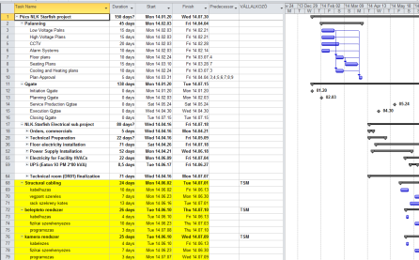
PLANNING
1. Initiation
2. Planning
3. Execution
4. Closing
Project manager, core project team
Detailed project plan, budget
Schedule
Deliverables
Resource
Budget
Risks
DETAILED PLANS

Slide 8
KICK OFF MEETING
Project Charter
REM, Risk register
Organization chart
Schedule
Budget
Communication plan

Slide 9
KICK OFF MEETING TIPS
Involving the whole project team
Participation of the project sponsor
Understanding the project goals
Highlighting the expectations regarding communications
Defining the first steps

Slide 10
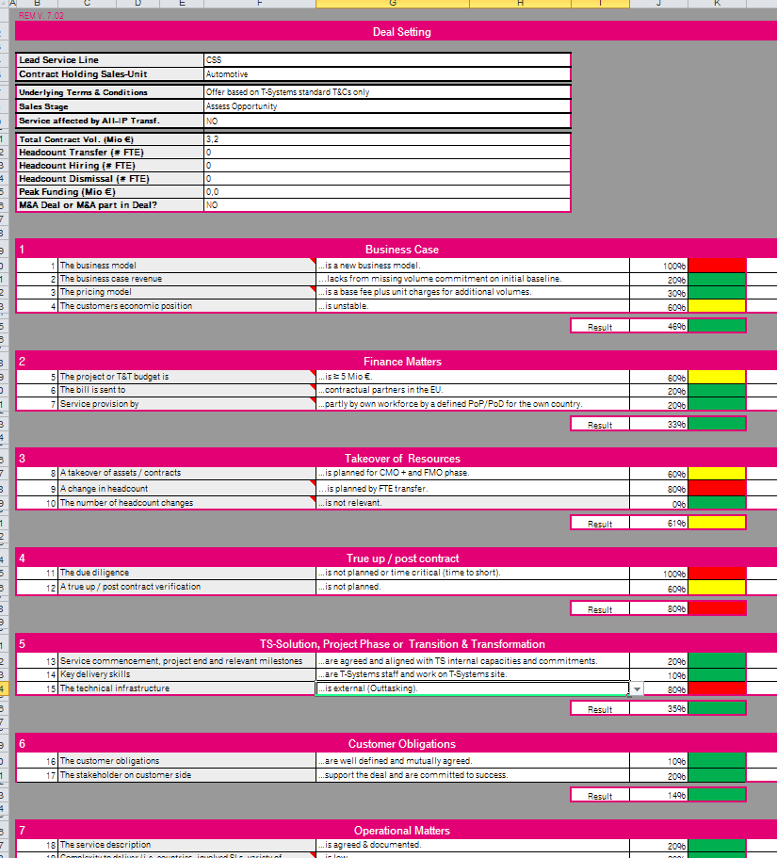
KICK OFF MEETING REM, Risk register
Low | Medium | High
Low | Medium | Medium
Low | Low | Low
Probability
Impact (Q, C, T)

Slide 11
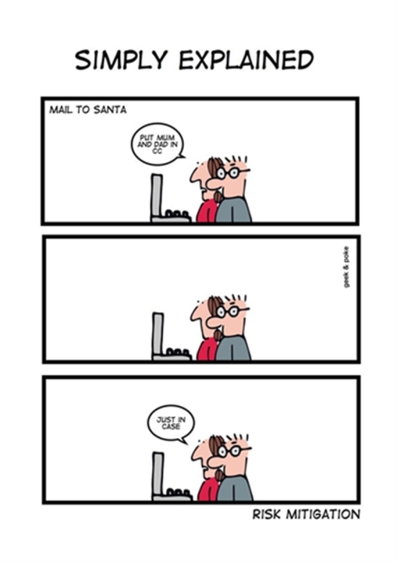
Risk management – Risk Response Strategies
Threats:
Avoid
Mitigate
Transfer
Opportunities:
Exploit
Enhance
Share
Threats/Opportunities
Accept

Slide 12
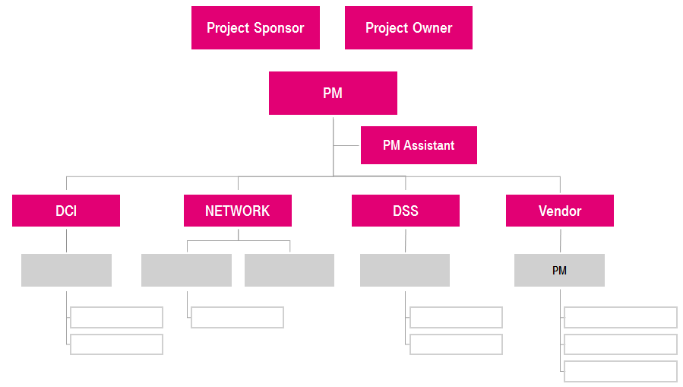
KICK OFF MEETING ORGANIZATION CHART
MATRIX ORGANIZATIONAL STRUCTURE
PROJECT ORGANIZATION
ESCALATION PATH

Slide 13
KICK OFF MEETING SCHEDULE
DEFINING MAIN MILESTONES
PLANNING DEADLINES
2013
Activities
September
October
November
December
Project Setup
Planning, team setup
Kick off
2013.09.30.
Execution
QG rollout
Adoption
Rollout
Process development
Workshops
Approval
Approved T&T NS Process
2013.11.22.
Closing
Project closing
Project is closed
2013.12.20.

Slide 14
KICK OFF MEETING Communication plan
IDENTIFYING TARGET AUDIENCE
IDENTIFING COMMUNICATION TOOLS
PLANNING COMMUNICATION CHANNELS
What | When | From whom | To whom
Status report | Biweekly | Program manager | Program SC members
SC call | Monthly | Program manager | Program SC members
Escalation | As needed | Program manager | Program SC members
PM call | Biweekly | Program manager | Program manager
Project status documents | Weekly | Program manager | Program manager

Slide 15
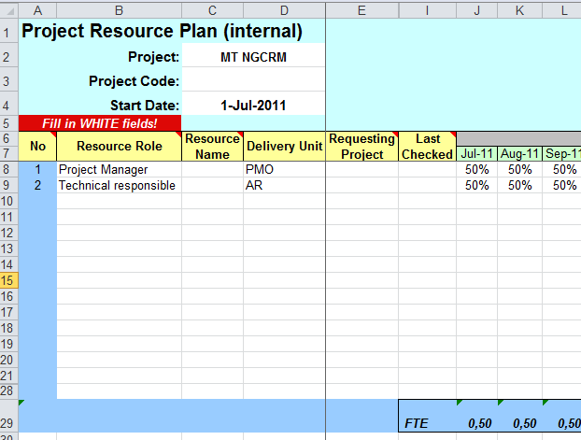
KICK OFF MEETING BUDGET
RESOURCE ALLOCATION
DETAILED BUDGET ON AN AGREED LEVEL
EXPENSES
CAPEX
OPEX
External OPEX
OPEX WH

Slide 16
PROJECT Process Groups
Planning processes
Monitoring & Controlling processes
Enter Phase / Start project
Initiating processes
Closing processes
Exit Phase / End project
Executing processes

Slide 17
project progress groups
Processes (47), process groups (5), knowledge areas (10)
Source: PMBOK Guide
 | Initiating | Planning | Executing | Controlling | Closing
Integration | Develop Project Charter | Develop Project Management Plan | Direct and Manage Project Work | Monitor and Control Project Work Perform Integrated Change Control | Close Project or Phase
Scope |  | Plan Scope Management Collect Requirements Define Scope Create WBS |  | Validate Scope Control Scope
Time |  | Plan Schedule Management Define Activities Sequence Activities Estimate Activity Resources Estimate Activity Durations Develop Schedule |  | Control Schedule
Cost |  | Plan Cost Management Estimate Costs Determine Budget |  | Control Costs
Quality |  | Plan Quality Management | Perform Quality Assurance | Control Quality
HR |  | Plan Human Resource Management | Acquire Project Team Develop Project Team Manage Project Team
Comm. |  | Plan Communications Management | Manage Communications | Control Communications
Risk |  | Plan Risk Management Identify Risks Perform Qualitative Risk Analysis Perform Quantitative Risk Analysis Plan Risk Responses |  | Control Risks
Proc. |  | Plan Procurement Management | Conduct Procurements | Control Procurements | Close Procurements
Stakeholder | Identify Stakeholders | Plan Stakeholder Management | Manage Stakeholder Engagement | Control Stakeholder Engagement

Slide 18
EXECUTIng/Controlling
1. Initiation
2. Planning
3. Execution
4. Closing
Project manager, project team, Sponsor, Stakeholders
Status reports
Execute project plan
Validate Scope
Project change management
Risk management
Communication
Stakeholder management
Control Schedule

Slide 19
Execution tasks
Acquire and manage project resources (by following HR and procurement management plans)
Manage task execution (based on the project management plan)
Implement the quality management plan (to ensure that work is performed in accordance with the quality standards)
Implement approved changes and corrective actions (by following change management plan)
Implement approved actions (by following risk management plan to minimize/optimize the impact of negative/positive risks)
Manage the flow of information (by following communication management plan)
Maintain stakeholder relationship (by following the stakeholder management plan)

Slide 20
Monitoring and controlling tasks
Measure project performance
Manage changes to the project (by following the change management plan)
Verify that project deliverables conform to the quality standards
Monitor and assess risk
Review the issue log, update if necessary and determine corrective actions
Capture, analyze and manage lessons learned
Monitor procurement activities (according to the procurement management plan)
Obtain formal approval on deliverables

Slide 21
Control Schedule
Monitoring the status of project to update the project progress

Slide 22
Change Management
The process of reviewing all change requests, approve changes, update project documents and project management plan
Identify change (PM/Project team/Sponsor/Stakeholders)
Analyze root cause/impact (PM)
Approved by PM (PM)
Generate change request (PM)
Approve change request (Change Advisory board)
Update baseline/document (PM)
Implement change (PM)

Slide 23
The project manager should…
Influence the factors that affect the change
Determine if a change is needed
Look for alternatives
Ensure that the change is beneficial and minimize negative impact
Notify stakeholders affected by the change
Manage the change
Determine if a change has occurred

Slide 24
project progress groups
Processes (47), process groups (5), knowledge areas (10)
Source: PMBOK Guide
 | Initiating | Planning | Executing | Controlling | Closing
Integration | Develop Project Charter | Develop Project Management Plan | Direct and Manage Project Work | Monitor and Control Project Work Perform Integrated Change Control | Close Project or Phase
Scope |  | Plan Scope Management Collect Requirements Define Scope Create WBS |  | Validate Scope Control Scope
Time |  | Plan Schedule Management Define Activities Sequence Activities Estimate Activity Resources Estimate Activity Durations Develop Schedule |  | Control Schedule
Cost |  | Plan Cost Management Estimate Costs Determine Budget |  | Control Costs
Quality |  | Plan Quality Management | Perform Quality Assurance | Control Quality
HR |  | Plan Human Resource Management | Acquire Project Team Develop Project Team Manage Project Team
Comm. |  | Plan Communications Management | Manage Communications | Control Communications
Risk |  | Plan Risk Management Identify Risks Perform Qualitative Risk Analysis Perform Quantitative Risk Analysis Plan Risk Responses |  | Control Risks
Proc. |  | Plan Procurement Management | Conduct Procurements | Control Procurements | Close Procurements
Stakeholder | Identify Stakeholders | Plan Stakeholder Management | Manage Stakeholder Engagement | Control Stakeholder Engagement

Slide 25
CLOSING
1. Project Initiation
2. Definition and Planning
3. Execution
4. Closing
Project manager
Project Final Report
Customer acceptance
Financial closing
Lessons learned
Release resources

Slide 26
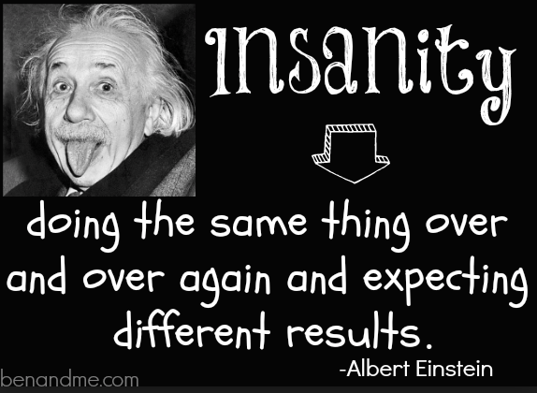
CLOSING

Slide 27
Questions?

