Slide 1
Project management
Pmo – the basics
Éva Németh
Nóra Kollárik

Slide 2
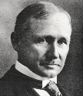
History of PMO
1910

Slide 3

History of PMO
1950s
1910

Slide 4


History of PMO
1980s
1950s
1910

Slide 5




History of PMO
1980s
1950s
1910
1990s

Slide 6






History of PMO
1980s
1950s
1910
PMO
PMO
PMO
1990s
PMO

Slide 7



Definition of pmo
A group or department that defines and maintains project management standards across an organization.
The keeper of documentation, guidance, and metrics for project execution, ensuring projects are completed on time and within budget.
Can also have certain privileges over projects that the PM is not entitled to (e.g. making business/strategic decisions to put on hold or stop a project completely)

Slide 8






Who needs a pmo?
You may need a PMO if:
Projects finish later than planned or over budget
Projects are not properly aligned with business goals/do not deliver business value
Stakeholders do not have visibility into project progress
No standardized process for initiating and executing projects
Project success cannot be tracked accurately
Skills and resources across projects and programmes are not efficiently used

Slide 9
levels of Pmo
PMOs operate according to the organization’s needs and goals, so each PMO is structured differently
Supportive PMO
Supplies guidelines, templates, best practice, training, some status reporting.
Has no or very little influence and control over projects.
Weak matrix
Controlling PMO
Requires compliance to organizational tools, processes, and standards applied.
In case of non-compliance, initiates and enforces corrective actions.
Has a moderate degree of control in projects.
Balanced matrix
Directive PMO
Takes over the management of the project by providing experience and resources.
This requires high maturity PMOs, usually professional project managers.
Has a high degree of control in projects.
Strong matrix

Slide 10
PMO maturity
Absent

Slide 11
PMO maturity
Initial
Absent

Slide 12
PMO maturity
Initial
Established
Absent

Slide 13
PMO maturity
Initial
Established
Grown up
Absent

Slide 14
PMO maturity
Initial
Established
Grown up
Mature
Absent

Slide 15
PMO maturity
Initial
Established
Grown up
Mature
Best in class
Absent

Slide 16
T&T PROJECT Organization sample – Mirrored Project Organization
Executive Steering Committee
Project Steering Committee
Customer
T-Systems
  Responsible for all PM related topics and interfacing with the organization on general requirements (planning, reporting, etc.).
  Responsible for supporting of PM related topics and interfacing with Customer PMO on general requirements (planning, reporting, etc.).
  Responsible for administration and content of project EPM and customer EPM (Enterprise Project Management tool).
Project Management Office
Program
Management
T&T Program
Management
Cross
Functions
PMO
PMO
Cross
Functions
Work-
stream A
Work-
stream A
Work-
stream B
Work-
stream B
Work-
stream X
Work-
stream X

Slide 17

Pmo key tasks
Reporting
Cost management
Support
Project management
Project information
Resource management
Communication

Slide 18


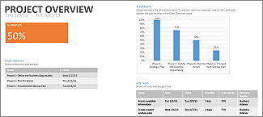

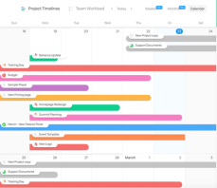

PMO tasks – initiation & planning 1/3
 | Description
 | Managing Resourcing Forecast Report ReM Tool entries for new & closing assignments Organizing Resourcing Reviews Time & Cost Tracking Collecting source data for Project Reporting Updating Risks & Issues & Action Items Log
 | Project Organization Chart Building out Communication Channels Collecting source data for Project Reporting Updating Risks & Issues & Action Items Log Meeting Minutes Monitoring Changes & updating Project Data Project Portfolio – central storage
 | All additionals to be requested by the Stream Lead Creating an overview of project specific processes, if necessary - MS Visio
GENERAL – REPORTING & TRACKING
COMMUNICATION MAPPING
CONSULTANCY
Notes:
13.08.2007
18
Autor / Thema der Präsentation

Slide 19
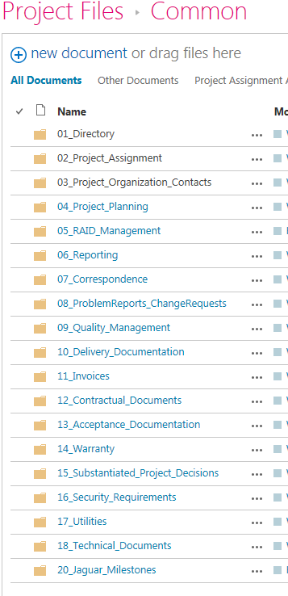

PMO Tool-KIT 2/3
GENERAL – TOOL KIT
 | Description
 | New Joiner Form & Kickstart 4 onboarding Resource Management Tool SharePoint Portal (central documental repository) SharePoint Portal (project-specific site) Project Knowledge Center Expense Tracking Tool Accounting System (optionally requested for PMOs) Customer Project Reporting Tool Miles+ (time-writing tool)
 | Defining cross-functions & dependencies
 | MS applications – be an expert
 | Your unique soft-skills
Notes:
13.08.2007
19
Autor / Thema der Präsentation

Slide 20

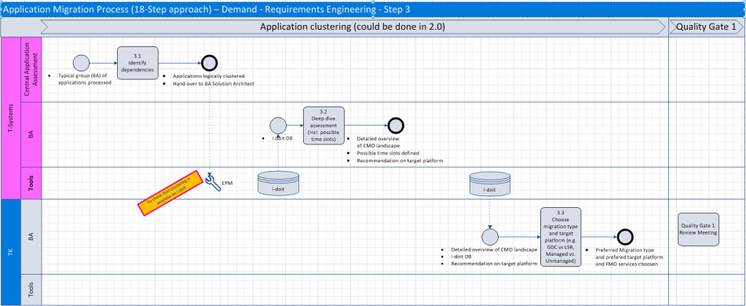
PMO roles & Tasks – on wide-scale 3/3

Slide 21
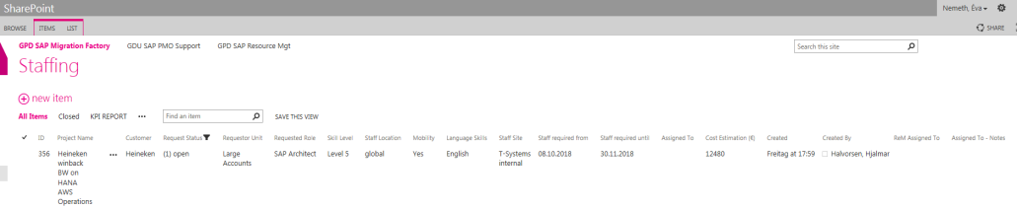
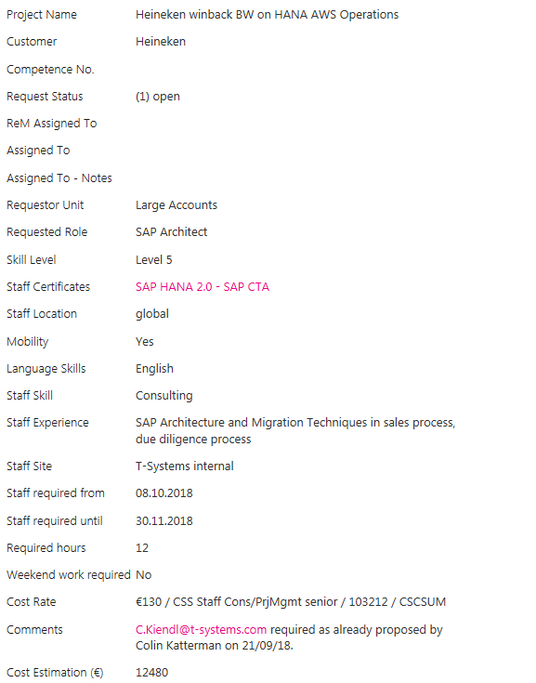
Resource management tool
Derives from Competence DB
1. PM initiates request
  2. ReM Team accepts
    3. Seek for suitable candidate
      4. Capacity is OK
      5. Candidate approved by PM

Slide 22

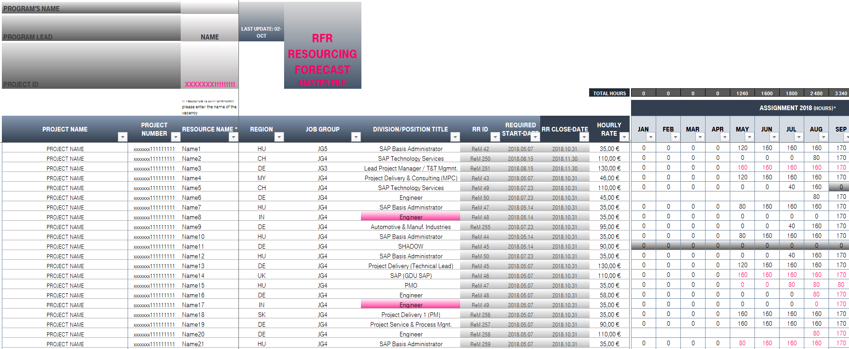
Resource forecast report

Slide 23

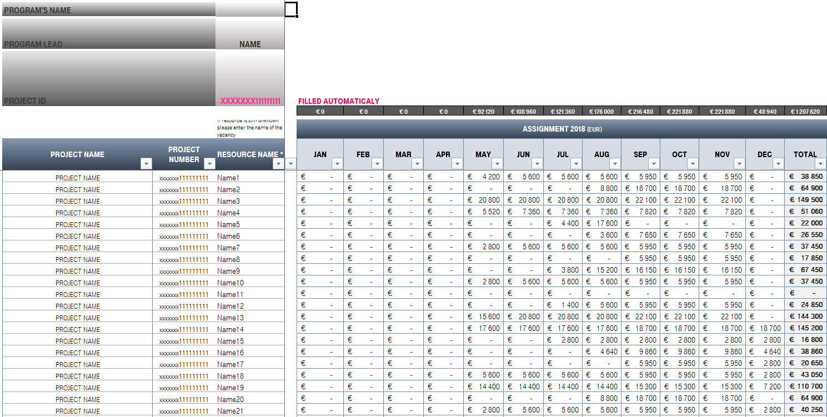
Resource forecast report

Slide 24
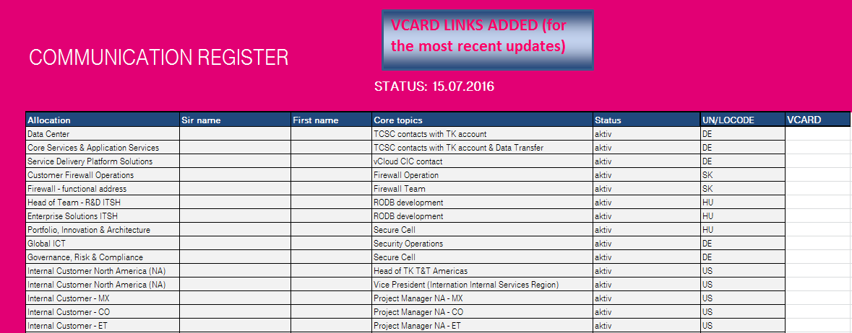
Communication register – simple

Slide 25
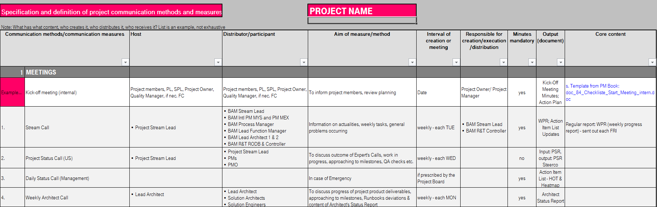
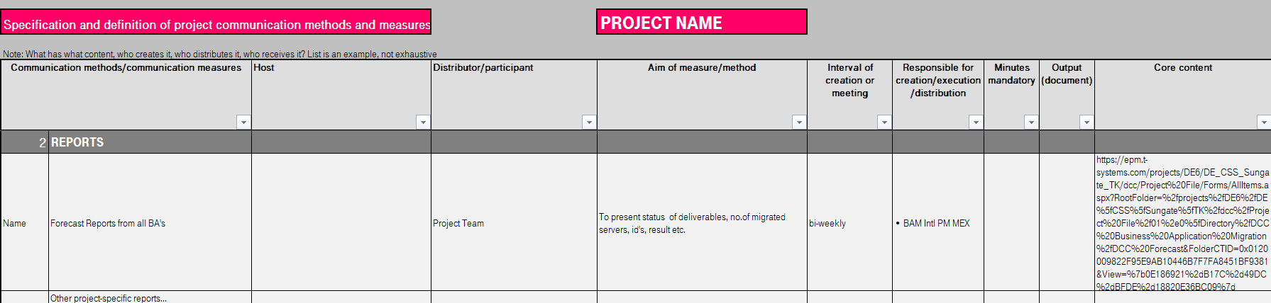
Communication calendar

Slide 26
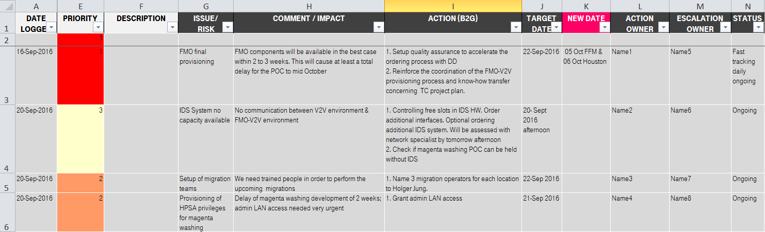
Risk/issue log & action item list

Slide 27
PMO’s Reporting basics
Red
Critical issues could not be solved.
Management review and decisions are necessary, the impact on business case and/or contractual milestone is likely or visible already. (e.g. agree on new budgets).
Amber
Might require management review.
Critical issues are identified or not yet solved. If issues are not solved within reasonable timeframe they will impact the business case and/or the deliverables.
Green
No extra attention and action required.
All critical issues are under control. Business case and deliverables are on track. Customer is satisfied with T-Systems overall.
Always applicable: If project status or one of the reported KPIs (time, budget, quality)
is not green, back to green measures need to be set up as soon as possible.

Slide 28

PMO success factors
commitment of executive management is crucial
The role of the PMO must be clearly defined
Learn how to walk before you try to run
Not mature enough?
Focus on Quick-wins
The PMO will only improve project performance if usage of proper processes and techniques are encouraged
Pmp certification for mature PMO members

