Slide 1
IT SERVICES HUNGARY PROJECT MANAGEMENT 1

Slide 2
PROJECT MANAGEMENT 1 – details & Requirements
Subject name: Project management 1
Occasion: 2 lessons per week
Credit value: 3
Date of subject: Academic year 2019-2020, Autumn semester
Type of subject: Compulsory
Faculty: Engineering and Information Technology, University of Pécs, ITSH Office
Subject responsible: Tibor Varga
Mandatory requirements:
Participation in lectures (2 absenteeism is allowed without official excuse)
Higher than 50% success rate on the exam
Course Requirement: Exam (written)
Lecture notes: presenter’s slide deck

Slide 3
PROJECT MANAGEMENT 1 – agenda

Slide 4
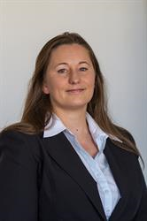
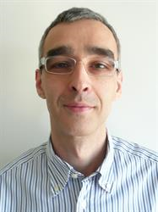
PROJECT MANAGEMENT 1 - lecturers
Project Management
T-Systems delivers information & communication technology solutions for major corporations and public-sector organizations worldwide.
Timea Zengő
Imre Szanyi

Slide 5
PROJECT MANAGEMENT 1

Slide 6
IT Services Hungary Company introduction

Slide 7
DEUTSCHE TELEKOM (DT)
PARTNER FOR CONNECTED LIFE AND WORK
Telekom
T-Systems
The Telekom subsidiaries provide products and services for mobile communications, fixed network, IPTV, online and cloud services in 50 countries.
T-Systems delivers information & communication technology solutions for major corporations and public-sector organizations worldwide.

Slide 8
T-SYSTEMS INTERNATIONAL
DEUTSCHE TELEKOM’S SUBSIDIARY FOR MAJOR CORPORATIONS A GLOBAL PLAYER WITH GLOBAL RESOURCES
INTERNATIONAL PRESENCE
REVENUE
€7,9 billion*
*2016 figures
Offices in over 20 countries, global delivery capability
MARKET POSITION
No. 1
No. 2
No. 2
Information & Communication Technology provider in Germany
Project Services in Germany
Manufacturing in Europe, middle east, Africa
FOCUS
EMPLOYEES
Large corporations, multi-national companies, public sector and healthcare organizations
Approx. 43 000*
*2016 figures

Slide 9
T-SYSTEMS WORLDWIDE PRESENCE* Outside Europe
St. Petersburg, Russia
Moscow, Russia
Beijing, China
Chicago, USA
Phoenix, USA
Tokyo, Japan
Hong Kong
Puebla, México
Pune, India
Selangor, Malaysia
Singapore
São Paulo, Brazil
Midrand, South Africa
*Countries and seats, as of 2015.08.24

Slide 10
T-SYSTEMS PRESENCE IN EUROPE* OUTSIDE GERMANY
Ballerup, Denmark
Vianen, Netherlands
Malmö, Sweden
Oslo, Norway
Stockholm, Sweden
Luxembourg, Luxembourg
Helsinki, Finland
Groot-Bijgaarden, Belgium
Wroclaw, Poland
Prague, Czech Republic
London, United Kingdom
Košice, Slovakia
Paris, France
Budapest, Hungary
Kiev, Ukraine
Wien, Austria
Bukarest, Romania
Lisboa, Portugal
Istanbul, Turkey
Porto Salvo, Portugal
Barcelona, Spain
Zollikofen, Switzerland
*Countries and seats, as of 2015.08.24

Slide 11
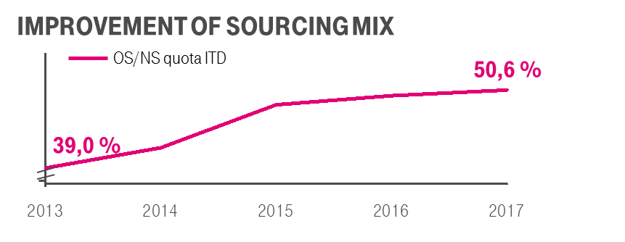
THE NEARSHORE BUSINESS
NEARSHORING
The transfer of business or IT processes to companies in a nearby country, often sharing a border.
Both parties expect to benefit from one or more of the following dimensions of proximity:
economic, political or historical linkages
geographic
time zone
cultural
linguistic
Planned Nearshore / Offshore ratio compared to the Total number of Full Time Equivalents in T-Systems Delivery.

Slide 12
ABOUT US IT SERVICES HUNGARY

Slide 13
OWNERSHIP STRUCTURE
Products and services for mobile communications, fixed network, IPTV, online and cloud services in 50 countries.
Deutsche Telekom AG
100%
59,21%
Information & communication technology solutions for major corporations and public-sector organizations worldwide
International
100%
100%
T-Systems ICT Romania S. R. L.
Hungary
Information & communication technology outsourcing for nearshore and global customers
Information & communication technology services and solutions for local customers (HU)
MU IT
MU TC
Telekom IT
DT Technik

Slide 14
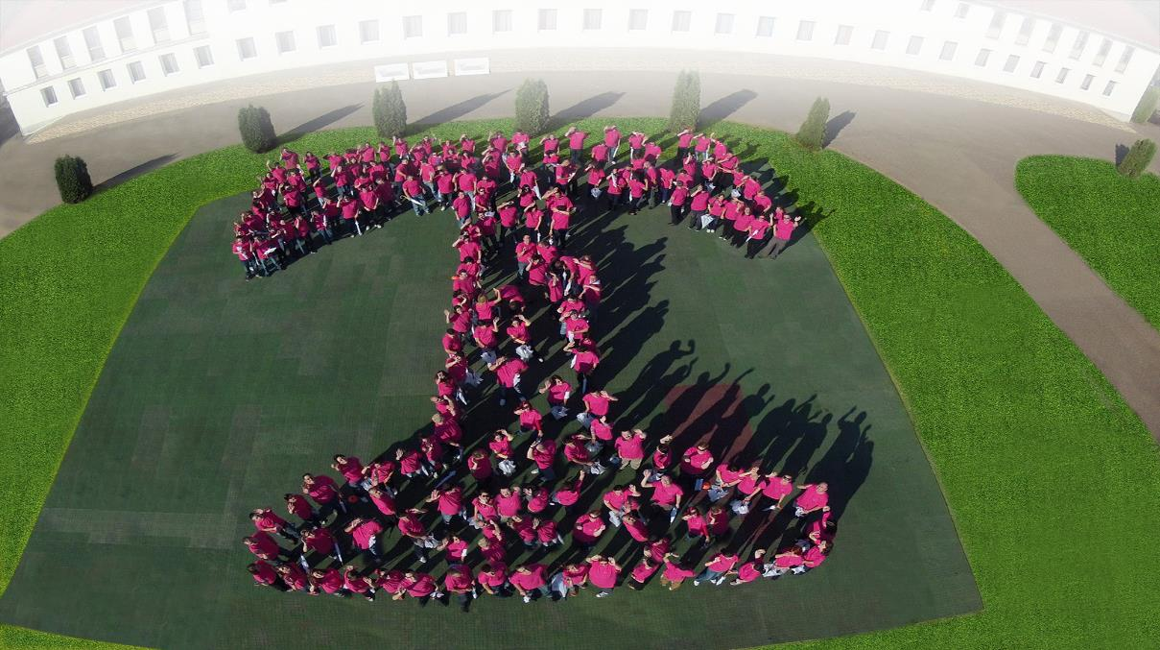
ITSH IN A NUTSHELL
Full information & communication technology operations portfolio
End-to-end Services
Delivery capacity
Economies of scale
More major sites (Business Continuity Planning, Cost Efficiency)
More languages, German among them
Part of EU, same time zone and culture with our customers
ISO9001, ISO27001, ISO20 000-1, ISO14001, OHSAS18001
Capacity Maturity Model Integration Certificate
Renewed Umbrella certification in 2014
ITSH as a company

Slide 15
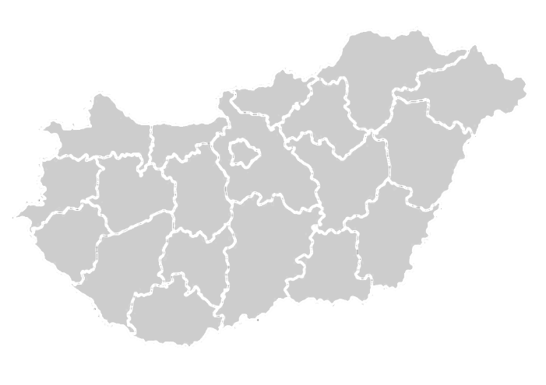
ABOUT IT SERVICES HUNGARY
Established in 2007
100% owned Hungarian subsidiary of T-Systems International
Serves our international clients in operational areas on four Business Divisions
Largest ICT employer of Hungary
Employees and Skills
Average age: 32 years
100% speak one foreign language, 45% German AND English
86% has at least one degree
Company Certifications
ISO9001, ISO27001, ISO20 000-1, ISO14001, OHSAS18001
CMMI Certificate
Renewed Umbrella certification
2095
1615
BUDAPEST
DEBRECEN
Pécs, Debrecen and Budapest are fully equipped Business Continuity solutions.
225
szeged
PÉCS
541
INTERNAL FTE as of 12/2018

Slide 16
We CREATed A DIVERSE AND COLORFUL COMPANY…
2018 YE As of ACT 12/2018
Classic it
Growth portfolio
Digital Division Services
TEL IT
Telekom Security
TC core
IP Production Services
GDE
Telekom IT
Solutions & Projects
Systems Integration
Central End-user Services
Merged to Global IT Operations
Telecommunication Services and Solutions
Business Operations & Quality
Global IT Operations
Global Partner Management & End-User-Services
Service Management & Field Service
2005
2006
2007
2008
2009
2010
2011
2012
2013
2014
2015
2016
2017
2018

Slide 17
… by young and talented PEOPLE with great diversity…
AGE STRUCTURE
MALE
FEMALE
COLLEAGUES from
29 NATIONS
PROPORTION OF WOMEN
37,1% (ITSH)
37,5% (Mg1-5)

Slide 18
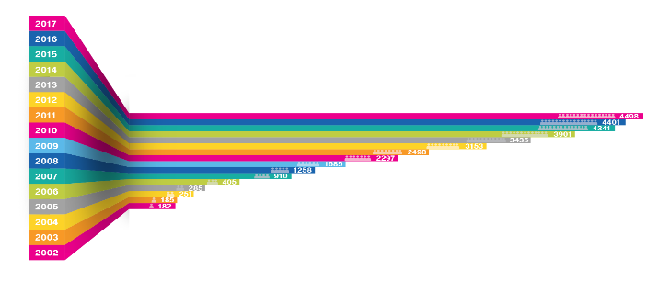
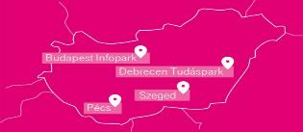
ABOUT OUR COMPANY
As a Hungarian subsidiary of T-Systems International IT Services Hungary serves our international clients in operational areas on seven Service Centers in four cities: Budapest, Debrecen, Pécs and Szeged.

Slide 19
EMPLOYER DEVELOPMENT
& BRANDING
EDUCATION
23% IT Degree 5% Engineer’s Degree 59% Other Degree 14% Secondary School
EDUCATION
2015
IT Services Hungary won the „Investor of the Year” Award for its regional developments associated with job creation!
2016
IT Services Hungary is the 8th most attractive enterprise in Hungary, according to a survey conducted among local employees by Randstad.
2012
IT Services Hungary became the largest ICT employer in Hungary!
SPOKEN LANGUAGES
79% english 64% german 13% other
2018
IT Services Hungary become „The Most Successful ICT Company in Hungary 2017” Award!
45% german and english
SPoken BOTH LANGUAGES

Slide 20
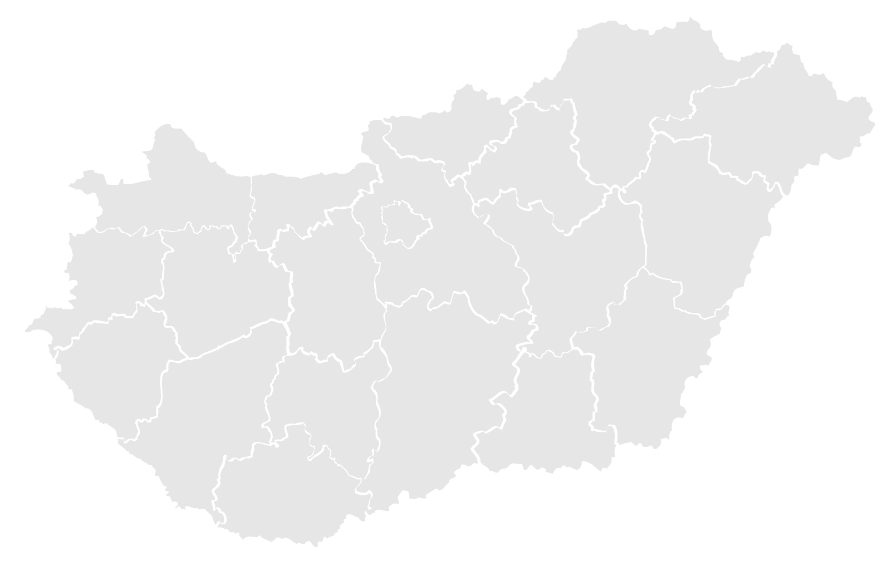
ITSH LOCATIONS UNIVERSITY Partnerships
University of SZEGED
Due to recent growth of Szeged
Due to recent growth of Szeged site, a cooperation agreement has been closed with Szeged University, where the Faculty of Informatics and Germanistics will jointly establish and run an IT Specialization program for last year students of the Germanistic Faculty.
University of pécs
As a result of a long-term agreement, the University of Pécs offers:
PM, OTC, ITIL, Network courses under the Affiliated ITSH
Department since autumn 2016
Dual education program with ITSH and the IT department
University of Debrecen
The cooperation between the University of Debrecen and ITSH has resulted in:
The establishment of the Affiliated Department of ICT Systems Operation
The Faculty of Informatics offering operating systems and networks specializations for university students regardless of their majors
The Germanistic Faculty offering a dedicated IT specialization
Scholarship and award programs.
20

Slide 21
…WITH a LEADERSHIP TEAM taking care of the success of
CEO
Erik Slooten
VP GROWTH PORTFOLIO
László Kónya
VP CLASSIC IT
Stephen Buswell
VP TC CORE
Beáta Szoták
VP TELEKOM IT
Örs Cseresnyés
Head of GDE
Zoltán Tivolt
VP FICO
Katalin Ollárné Riedl
VP HUMAN RESOURCES
Mariann Mészáros
Head of TRANS- FORMATION
OFFICE
Diána Cenov (act.)

Slide 22
WHAT WE OFFER FOR OUR EMPLOYEES
Stable working place
Language courses
Cafeteria
Innovative tasks
Young company spirit
Professional trainings
Sport opportunities
Carrier opportunity:
It is supported to move within the department after 6 month, after 1,5 years within the company
Company events
Facebook/LinkedIn community
22

Slide 23
Thank you! Questions?

Slide 24
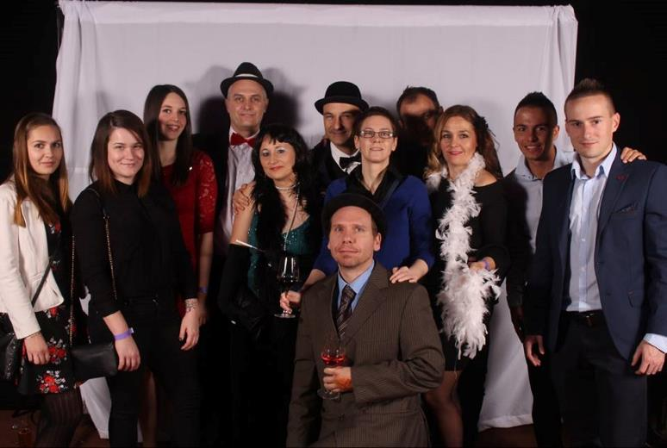
Year end party 2017

