Slide 1
Project management introduction
Beáta Neidert, Tibor Varga, Imre Szanyi, Timea Zengő

Slide 2
Agenda
01 | Introduction
02 | Vasa project
03 | Project management history
04 | ITIL
05 | Project
06 | Management
07 | Project Management
08 | Project vs Operation
09 | Project Program Portfolio
10 | PM Methods
11 | PM/PMO roles
12 | Project/Product life cycle

Slide 3







Introduction
Timea Zengő
Experience:
  Elcoteq 1999 – 2008
  Ericsson 2008 – 2015
  ITSH 2015 - present
Qualifications:
  2017 T-systems internal PM certification
  2016 ITIL Foundation IT Service Management
  2015 Shell License to Operate
  2015 PMI PMP Certification
  2004 Information technology engineer / University of Pécs

Slide 4
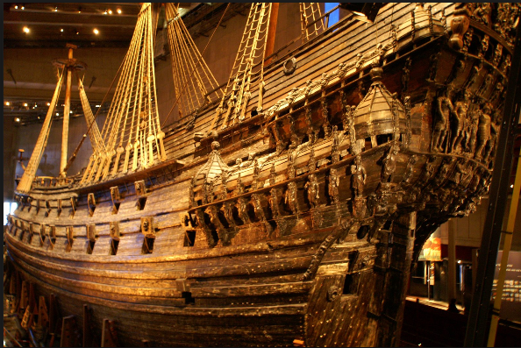
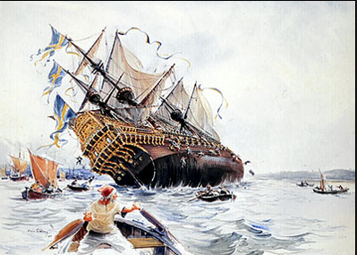
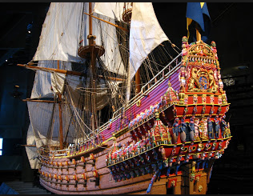
Vasa Warship Story– Stockholm - 1628

Slide 5
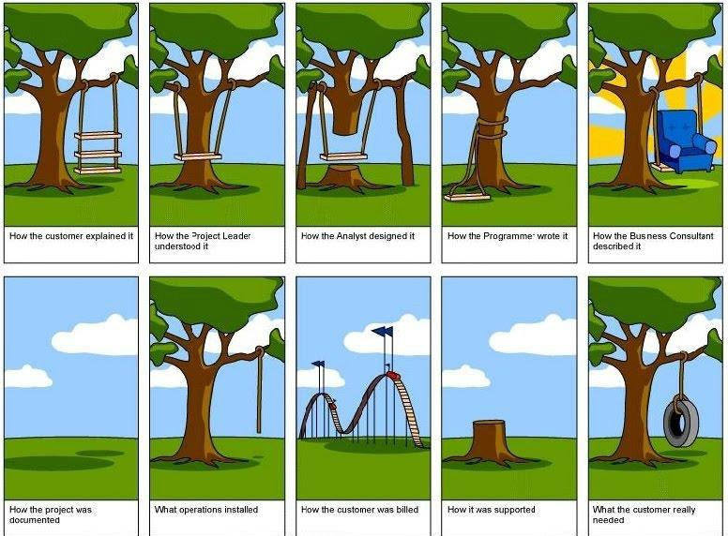
Project - different point of views

Slide 6
Project management history
Project management is the practice of initiating, planning, executing, controlling, and closing the work of a team to achieve specific goals and meet specific success criteria at the specified time.

Slide 7


Project management history

Slide 8
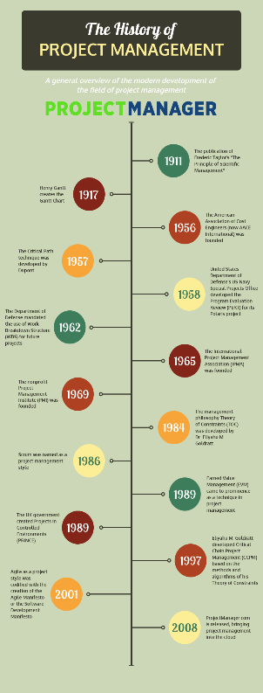
Project management history
Projects have been planned ever since people carry out larger tasks together.
The 1950s marked the beginning of the modern project management where core engineering fields come together to work as one.
In 1965 Project Management Association (IPMA) was founded (Western Europe)
In 1969 Project Management Institute (PMI) was founded (USA)
In 1989 Projects in Controlled Environments (PRINCE) was founded (UK)

Slide 9
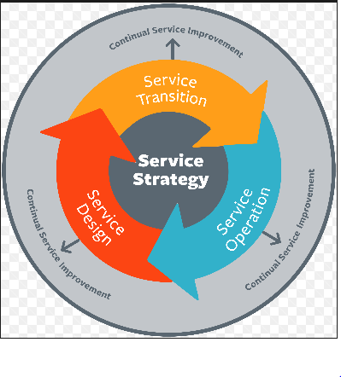
ITIL - Information Technology Infrastructure Library
ITIL is a library of volumes describing a framework of best practices for delivering IT services. Currently comprises five books, each covering various processes and stages of the IT service lifecycle.

Slide 10
project
Temporary endeavor (definite beginning and end)
Creating unique product, service or result for a purpose
Project constraints:
    scope of work, quality, budget, resources, schedule, risks, customer satisfaction

Slide 11
management
Strategic management involves the formulation and implementation of the major goals and initiatives taken by an organization's top management on behalf of owners, based on consideration of resources and an assessment of the internal and external environments in which the organization operates
Operations management is responsible for overseeing, directing, and controlling business operations. Operations evolve to support the day-to-day business, and are necessary to achieve strategic and tactical goals of the business.

Slide 12

project management
Application of knowledge, skills, tools and techniques to project activities to meet the project requirements
Goal oriented

Slide 13
project vs operation
Project | Operation
Creating new product/service/result | Repetitive product/service
Pre-defined start and end date | Continuous activity
Comprehensive knowledge is required | Specific knowledge
Temporally team | Permanent team
Unique | Repetitive and well-known

Slide 14
project vs operation
Project | Operation
Terv szerint dolgozók meghatározott költséggel. | Éves költségterv alapján dolgozik.
Megszüntetik, ha az előzetes célok nem teljesülnek. | A folyamatos működés majdnem minden körülmény ellenére biztosítva van.
Nehéz meghatározni és betartani a költségét és befejezésének idejét. | Az éves kiadások a korábbi tapasztalatok alapján kerülnek meghatározásra.

Slide 15
Project – Program- Portfolio
PORTFOLIO
Portfolio
PROGRAM
Program
Program
PROJECT
Project
Project
Project
Project

Slide 16
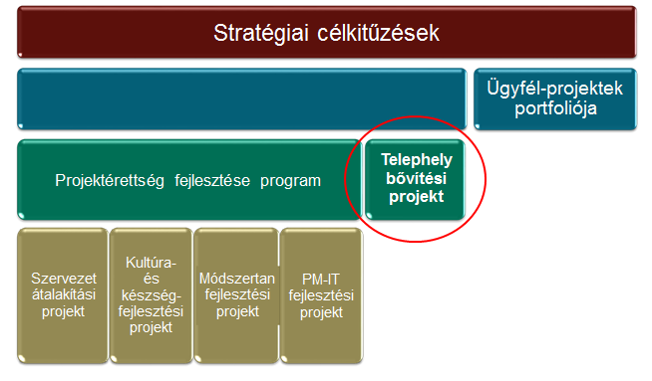
Project – Program- Portfolio

Slide 17
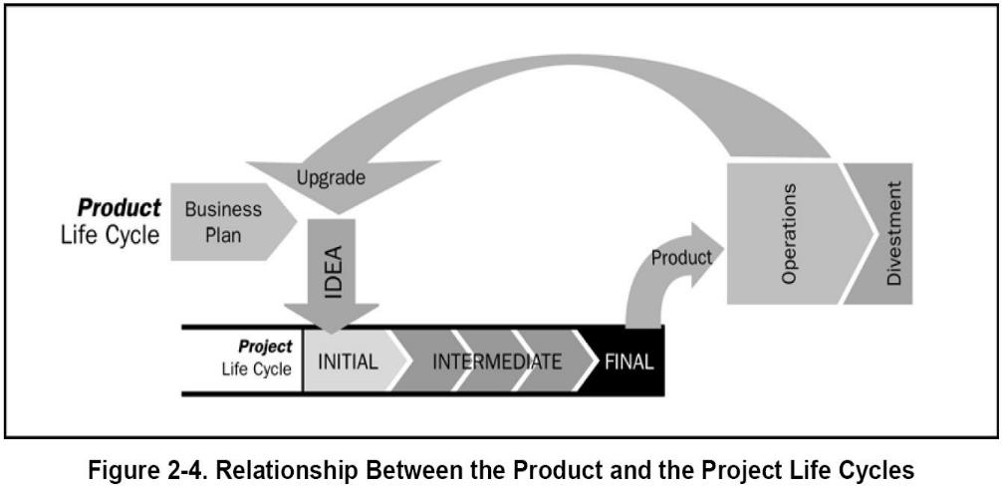
project life cycle / product life cycle

Slide 18
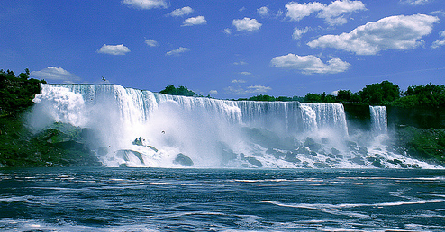
PROJECT MANAGEMENT methods
Waterfall Model
Iterative Model
Agile Model

Slide 19
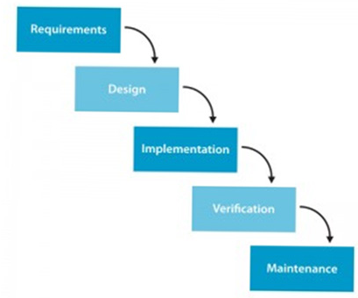
PM methods – Waterfall model
Detailed scoope at the beginning for the whole project ->
-> (master plan)
Change request after the master plan (smaller changes)

Slide 20
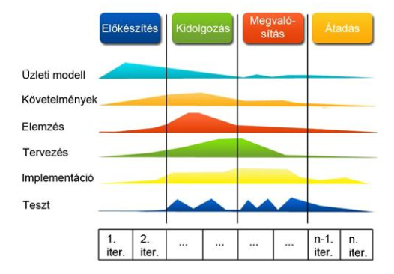
PM methods – Agile model
Do not have detailed scoope
Requirements list
Sprint (1,2…n)

Slide 21
project management roles – Project manager
Depends on the organizational structure, ultimate responsibility for the product quality of the project.
Knowledge (what the PM knows about project management)
Performance (what the PM is able to do or accomplish)
Personal (how the PM behaves when performing the project)

Slide 22
project management roles – PMO
Organizational unit to centralize and coordinate management of projects (programs)
Levels of PMO:
Supportive: PM support function (templates, training, best practices, lessons learned, etc.)
Controlling: provides support and requires compliance (frameworks, methodologies, tools) – moderate control
Directive: direct management of and responsibility for projects

Slide 23
Organization structures
Functional
Hybrid
Project Matrix
  Weak
  Strong
  Balanced

Slide 24










Organization structures - Functional
CEO
Engineering
Marketing
Manufacturing
Staff
Staff
Staff
Staff
Staff
Staff

Slide 25

Organization structures - Hybrid
Project director
CEO
Engineering
Marketing
Manufacturing
Staff
Staff
Staff
Staff
Staff
Staff

Slide 26










Organization structures – weak matrix
CEO
Engineering
Marketing
Manufacturing
Staff
Staff
Staff
Expediter, Coordinator
Staff
Staff

Slide 27









Organization structures – strong matrix
CEO
Manager of PMs
Engineering
Marketing
Manufacturing
Staff
Staff
Staff
Project manager
Staff
Staff
Staff

Slide 28
Organization structures – Balanced matrix
CEO
Engineering
Marketing
Manufacturing
Staff
Staff
Staff
Project manager
Staff
Staff

Slide 29
QUESTIONS?

