Slide 1
Project management
Project process groups
Imre Szanyi

Slide 2

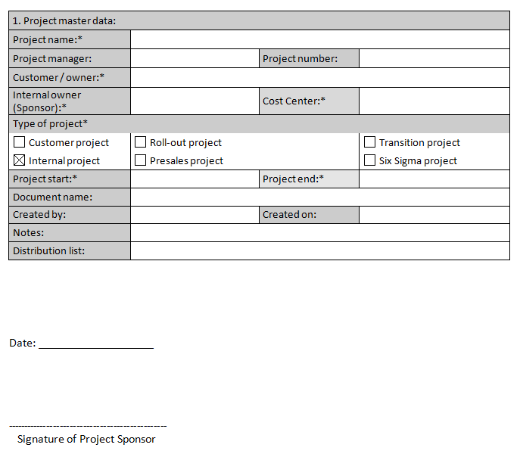

INITIATION
1. Initiation
2. Planning
3. Execution
4. Closing
Project Sponsor, Project manager
Project Charter
Timing
Roles
Stakeholders
Deliverables
Effects
Quality requirements of the result
MAIN INFORMATION, HIGH LEVEL PLANS

Slide 3
Initiation
PROJECT CHARTER
DEFINING THE SCOPE, SCHEDULE, REQUIREMENTS
Project master data
Project classification
Business case/need
High level project scope/out of scope, project deliverables, project success criteria
Project constraints and assumptions
Project budget (rough estimates)
Main stakeholders (team members, contractors, pre-assigned resources’ with roles, etc.)
High-level project requirements
High-level project risks

Slide 4
project progress groups
Processes (47), process groups (5), knowledge areas (10)
Source: PMBOK Guide
 | Initiating | Planning | Executing | Controlling | Closing
Integration | Develop Project Charter | Develop Project Management Plan | Direct and Manage Project Work | Monitor and Control Project Work Perform Integrated Change Control | Close Project or Phase
Scope |  | Plan Scope Management Collect Requirements Define Scope Create WBS |  | Validate Scope Control Scope
Time |  | Plan Schedule Management Define Activities Sequence Activities Estimate Activity Resources Estimate Activity Durations Develop Schedule |  | Control Schedule
Cost |  | Plan Cost Management Estimate Costs Determine Budget |  | Control Costs
Quality |  | Plan Quality Management | Perform Quality Assurance | Control Quality
HR |  | Plan Human Resource Management | Acquire Project Team Develop Project Team Manage Project Team
Comm. |  | Plan Communications Management | Manage Communications | Control Communications
Risk |  | Plan Risk Management Identify Risks Perform Qualitative Risk Analysis Perform Quantitative Risk Analysis Plan Risk Responses |  | Control Risks
Proc. |  | Plan Procurement Management | Conduct Procurements | Control Procurements | Close Procurements
Stakeholder | Identify Stakeholders | Plan Stakeholder Management | Manage Stakeholder Engagement | Control Stakeholder Engagement

Slide 5
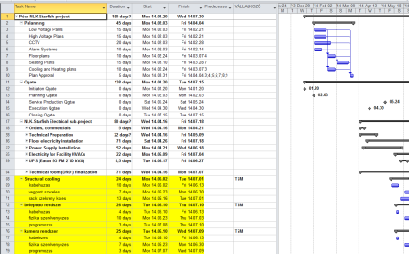

PLANNING
1. Initiation
2. Planning
3. Execution
4. Closing
Project manager, core project team
Detailed project plan, budget
Schedule
Deliverables
Resource
Budget
Risks
DETAILED PLANS

Slide 6

KICK OFF MEETING
Project Charter
REM, Risk register
Organization chart
Schedule
Budget
Communication plan

Slide 7

KICK OFF MEETING TIPS
Involving the whole project team
Participation of the project sponsor
Understanding the project goals
Highlighting the expectations regarding communications
Defining the first steps

Slide 8

Integration Management

Slide 9


Project Scope Management

Slide 10
KICK OFF MEETING
SCHEDULE
DEFINING MAIN MILESTONES
PLANNING DEADLINES
2013
Activities
September
October
November
December
Project Setup
Planning, team setup
Kick off
2013.09.30.
Execution
QG rollout
Adoption
Rollout
Process development
Workshops
Approval
Approved T&T NS Process
2013.11.22.
Closing
Project closing
Project is closed
2013.12.20.

Slide 11
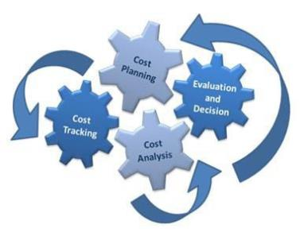
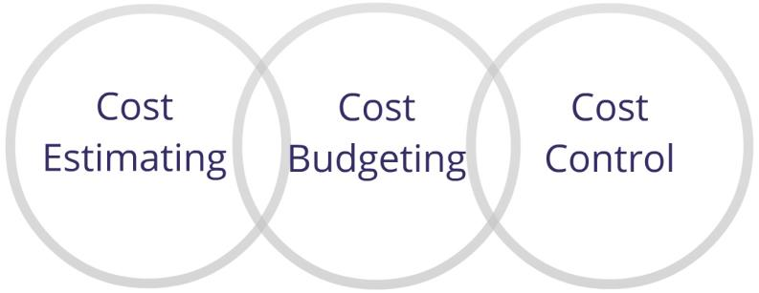
Project Cost Management

Slide 12
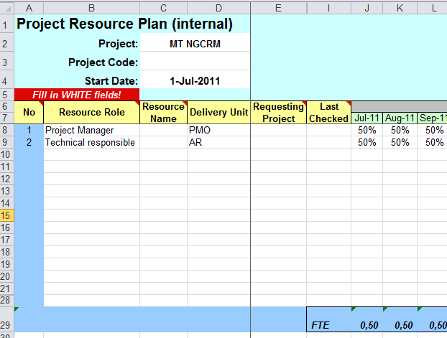
KICK OFF MEETING
BUDGET
RESOURCE ALLOCATION
DETAILED BUDGET ON AN AGREED LEVEL
EXPENSES
CAPEX
OPEX
External OPEX
OPEX WH

Slide 13


Project Quality Management

Slide 14
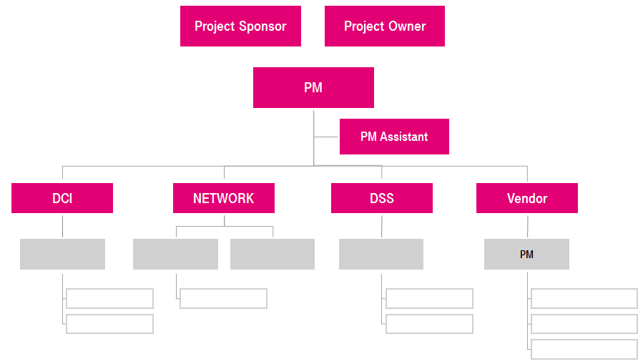
KICK OFF MEETING
ORGANIZATION CHART
MATRIX ORGANIZATIONAL STRUCTURE
PROJECT ORGANIZATION
ESCALATION PATH

Slide 15
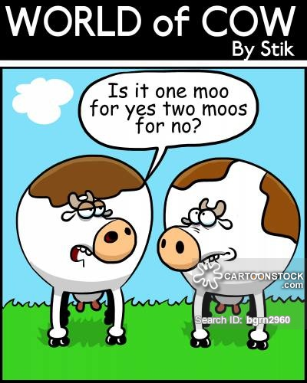
Project Communication Management

Slide 16
KICK OFF MEETING
Communication plan
IDENTIFYING TARGET AUDIENCE
IDENTIFING COMMUNICATION TOOLS
PLANNING COMMUNICATION CHANNELS
What | When | From whom | To whom
Status report | Biweekly | Program manager | Program SC members
SC call | Monthly | Program manager | Program SC members
Escalation | As needed | Program manager | Program SC members
PM call | Biweekly | Program manager | Program manager
Project status documents | Weekly | Program manager | Program manager

Slide 17
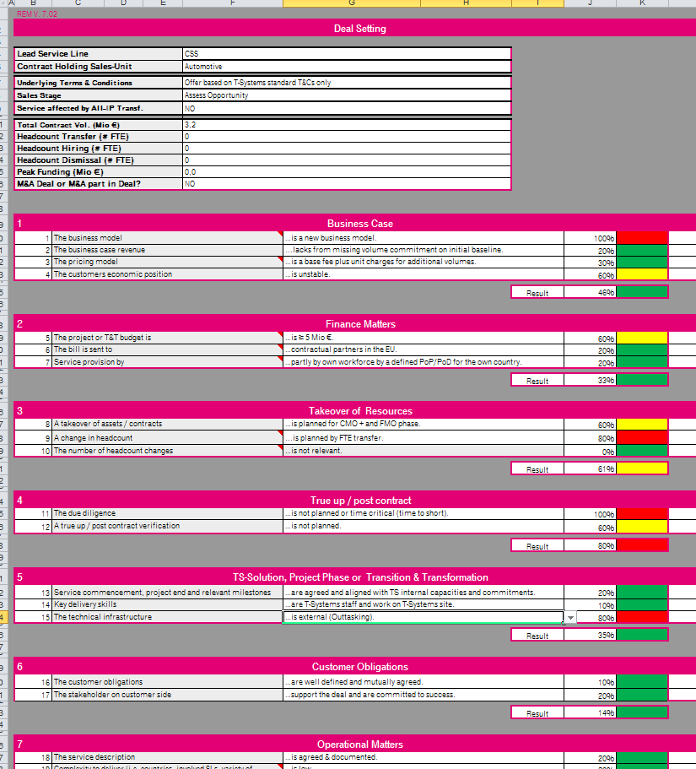
KICK OFF MEETING
REM, Risk register
Low | Medium | High
Low | Medium | Medium
Low | Low | Low
Probability
Impact (Q, C, T)

Slide 18

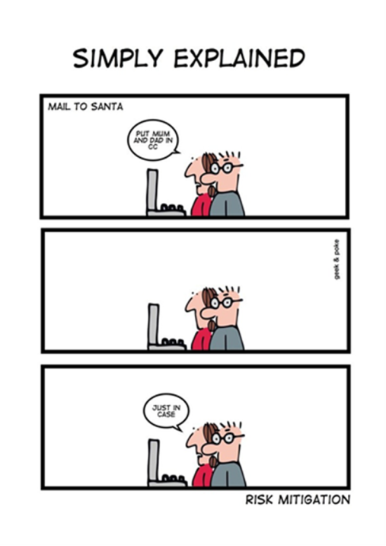
Risk management – Risk Response Strategies
Threats:
Avoid
Mitigate
Transfer
Opportunities:
Exploit
Enhance
Share
Threats/Opportunities
Accept

Slide 19


Project Procurement Management

Slide 20

Stakeholder management
Project Stakeholder Management includes the processes required to identify the people, groups, or organizations that could impact or be impacted by the project, to analyze stakeholder expectations and their impact on the project, and to develop appropriate management strategies for effectively engaging stakeholders in project decisions and execution.

Slide 21

Stakeholders
Who are actively involved in the project and/or
whose interests may be affected by the performance or completion of the project.

Slide 22

StakeholDers – main players
Customer
Project Sponsor
Project manager
Project team
Steering Commitee
Vendors
Other external members

Slide 23
Identify stakeholders
Project Stakeholders
Portfolio
Manager
Steering Commity
Sponsor
Functional Managers
Operations
Mgmt.
Program Manager
Project Team
Sellers/ Business Partners
Core team
Other Team
Project Manager
Members
PMO
Customers Users
The Project

Slide 24
Stakeholder analysis
Multiple classifications:
1. Power/interest grid
High
Keep Satisfied
Manage Closely
Power/influence grid
Influence/impact grid
Power
Monitor
Keep Informed
Low
Low
Interest
High

Slide 25







Stakeholder analysis - Example
CEO
Project manager
Sub-contractor
Head of finance
Head of HR
Real estate agency
Head of
development
High
1
4
2
5
Power
7
3
6
Low
Low
Interest
High

Slide 26
Steering Commitee
Project Steering Committee
ACR: Account Customer Responsible
CFR: Contract Fulfillment Responsible
CSR: Customer Solution Responsible
Project Sponsor
ACR
CFR
CSR
Project manager
Project team
Supplier

Slide 27
Stakeholders – Bóly FTTH & 3Play services

Slide 28
Project team - Bóly FTTH & 3Play services

Slide 29

EXECUTION
1. Initiation
2. Planning
3. Execution
4. Closing
Project manager, project team
Status reports
Execute project plan
Project change management
Risk management
Communication
Stakeholder management

Slide 30

CLOSING
1. Project Initiation
2. Definition and Planning
3. Execution
4. Closing
Project manager
Project Final Report
Customer acceptance
Financial closing
Lessons learned
Release resources

