Slide 1
IT SERVICES HUNGARY PROJECT MANAGEMENT 2
Notes:
Welcome
1st time ->introduction (subject, company)
Background info
ISTH supports the University
What is this subject about?
Have you ever hearder about PM or project?
What is the goal of this subject?
We’d like to teach practical things (PM1- with some basics, PM2 practical tasks)

Slide 2
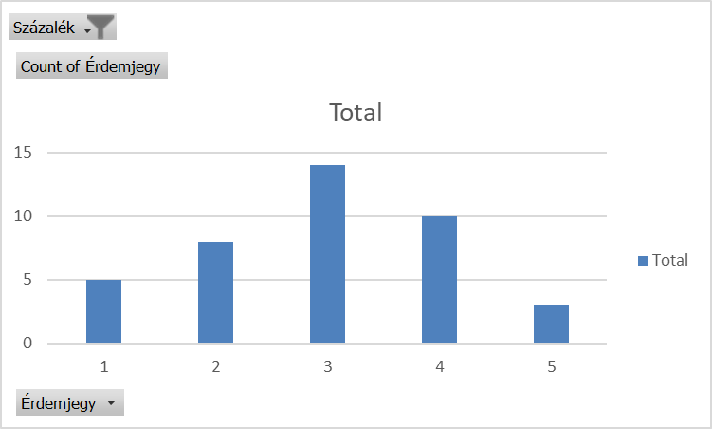
PROJECT MANAGEMENT 2 – TANTÁRGYI TEMATIKA

Slide 3
PROJECT MANAGEMENT 2 – details & Requirements
Subject name: Project management 2
Frequency: 2 lessons per week
Credit value: 3
Date of subject: Academic year 2018-2019, Spring semester
Type of subject: Compulsory
Faculty: Engineering and Information Technology, University of Pécs, ITSH Office
Subject responsible: Tibor Varga
Mandatory requirements:
Participation in lectures (2 absenteeism is allowed without official excuse)
2 submit papers during the semester
Higher than 50% success rate on the exam
(each grade has to be higher that 50%)
Course Requirement: Exam (written)
Lecture notes: presenter’s slide deck and exercises

Slide 4
PROJECT MANAGEMENT 2 – Agenda

Slide 5
project process groups
Processes (47), process groups (5), knowledge areas (10)
Source: PMBOK Guide
 | Initiating | Planning | Executing | Controlling | Closing
Integration | Develop Project Charter | Develop Project Management Plan | Direct and Manage Project Work | Monitor and Control Project Work Perform Integrated Change Control | Close Project or Phase
Scope |  | Plan Scope Management Collect Requirements Define Scope Create WBS |  | Validate Scope Control Scope
Time |  | Plan Schedule Management Define Activities Sequence Activities Estimate Activity Resources Estimate Activity Durations Develop Schedule |  | Control Schedule
Cost |  | Plan Cost Management Estimate Costs Determine Budget |  | Control Costs
Quality |  | Plan Quality Management | Perform Quality Assurance | Control Quality
HR |  | Plan Human Resource Management | Acquire Project Team Develop Project Team Manage Project Team
Comm. |  | Plan Communications Management | Manage Communications | Control Communications
Risk |  | Plan Risk Management Identify Risks Perform Qualitative Risk Analysis Perform Quantitative Risk Analysis Plan Risk Responses |  | Control Risks
Proc. |  | Plan Procurement Management | Conduct Procurements | Control Procurements | Close Procurements
Stakeholder | Identify Stakeholders | Plan Stakeholder Management | Manage Stakeholder Engagement | Control Stakeholder Engagement

Slide 6
Process groups
Planning processes
Monitoring & Controlling processes
Enter Phase / Start project
Initiating processes
Closing processes
Exit Phase / End project
Executing processes

Slide 7
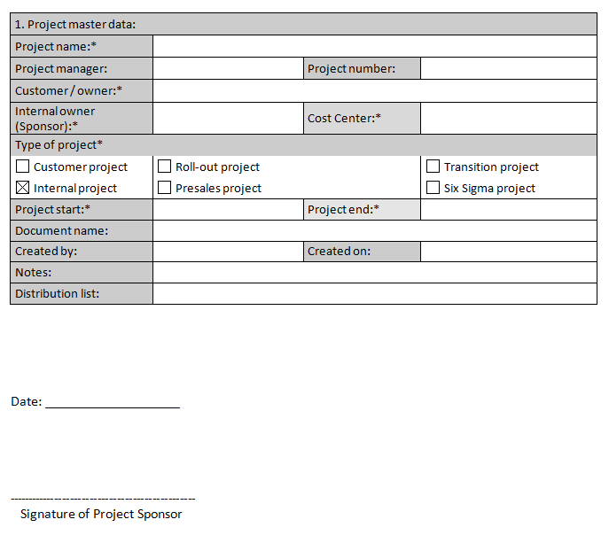
INITIATION
1. Initiation
2. Planning
3. Execution
4. Closing
Project Sponsor, Project manager
Project Charter
Timing
Roles
Stakeholders
Deliverables
Effects
Quality requirements of the result
MAIN INFORMATION, HIGH LEVEL PLANS

Slide 8
Initiation PROJECT CHARTER
DEFINING THE SCOPE, SCHEDULE, REQUIREMENTS
Project master data
Project classification
Business case/need
High level project scope/out of scope, project deliverables, project success criteria
Project constraints and assumptions
Project budget (rough estimates)
Schedule (high level)
Main stakeholders (team members, contractors, pre-assigned resources’ with roles, etc.)
High-level project requirements
High-level project risks

Slide 9
KICK OFF MEETING
Project Charter
REM, Risk register
Organization chart
Schedule
Budget
Communication plan

Slide 10
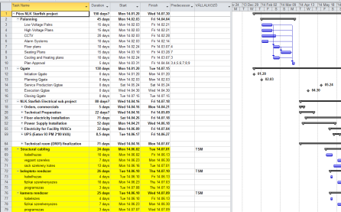
PLANNING
1. Initiation
2. Planning
3. Execution
4. Closing
Project manager, core project team
Detailed project plan, budget
Schedule
Deliverables
Resource
Budget
Risks
DETAILED PLANS

Slide 11
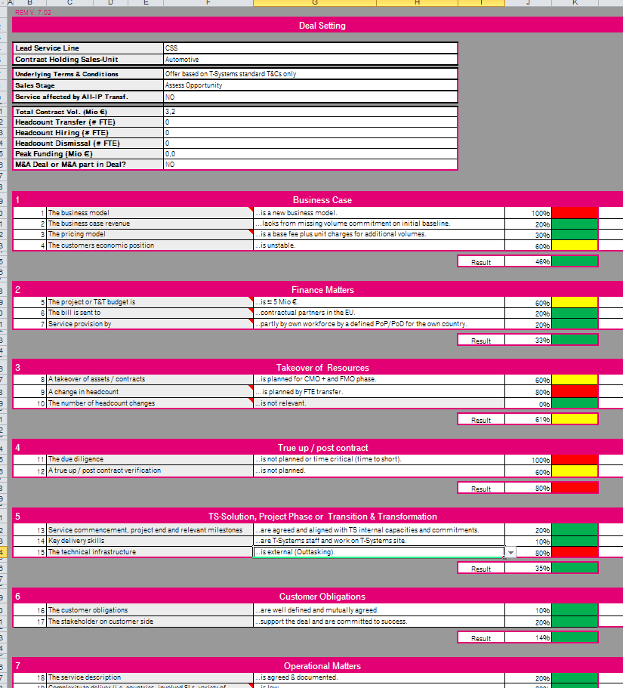
KICK OFF MEETING REM, Risk register
Low | Medium | High
Low | Medium | Medium
Low | Low | Low
Probability
Impact (Q, C, T)

Slide 12
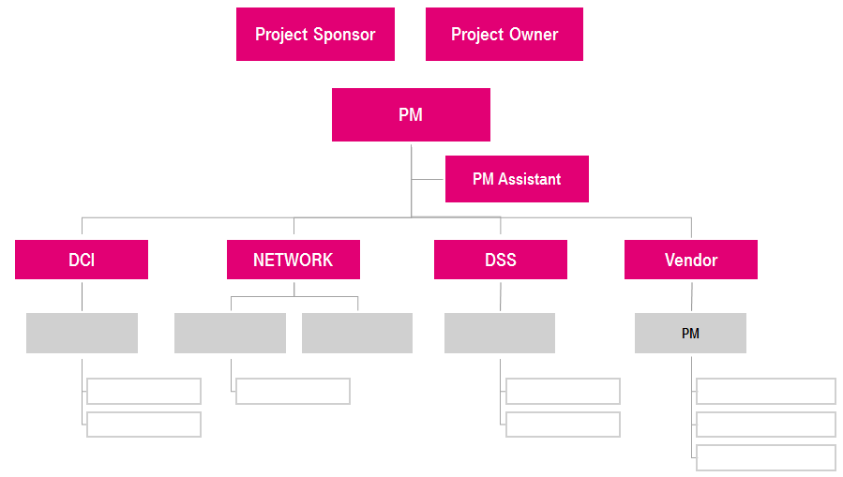
KICK OFF MEETING ORGANIZATION CHART
MATRIX ORGANIZATIONAL STRUCTURE
PROJECT ORGANIZATION
ESCALATION PATH

Slide 13
KICK OFF MEETING SCHEDULE
DEFINING MAIN MILESTONES
PLANNING DEADLINES
2013
Activities
September
October
November
December
Project Setup
Planning, team setup
Kick off
2013.09.30.
Execution
QG rollout
Adoption
Rollout
Process development
Workshops
Approval
Approved T&T NS Process
2013.11.22.
Closing
Project closing
Project is closed
2013.12.20.
Notes:
Mire jó:
Pontosan látszik, hogy követik egymást az egyes taskok
Milyen logikai kapcsolat van a taskok között
A mérföldkövek segítségével ellenőrizni tudjuk a P előrehaladását, és ezeket riportáljuk a managementnek
Megmutatni e timeplant

Slide 14
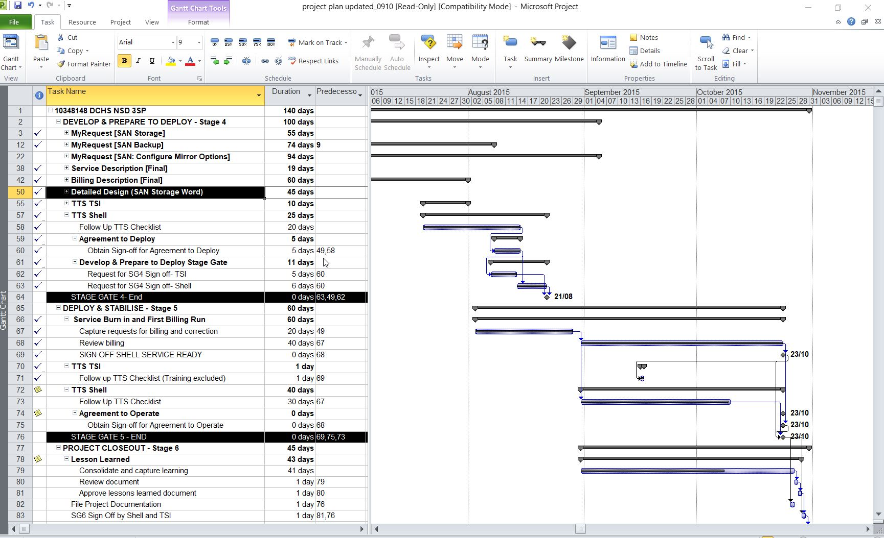
Notes:
P org chart

Slide 15
KICK OFF MEETING Communication plan
IDENTIFYING TARGET AUDIENCE
IDENTIFING COMMUNICATION TOOLS
PLANNING COMMUNICATION CHANNELS
What | When | From whom | To whom
Status report | Biweekly | Program manager | Program SC members
SC call | Monthly | Program manager | Program SC members
Escalation | As needed | Program manager | Program SC members
PM call | Biweekly | Program manager | Program manager
Project status documents | Weekly | Program manager | Program manager
Notes:
Megmutatni az communicaton plant a (next slide)

Slide 16
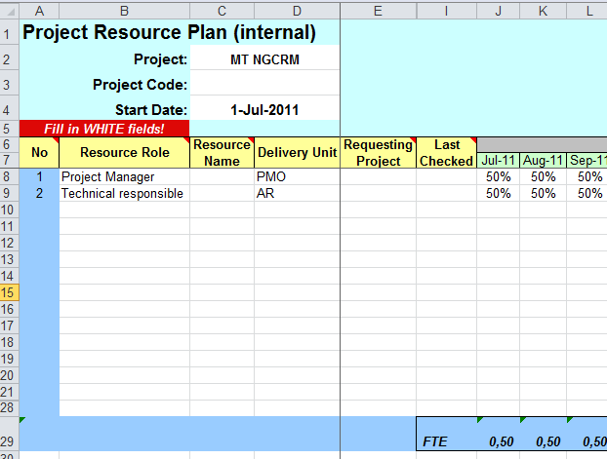
KICK OFF MEETING BUDGET
RESOURCE ALLOCATION
DETAILED BUDGET ON AN AGREED LEVEL
EXPENSES
CAPEX
OPEX
External OPEX
OPEX WH

Slide 17
EXECUTIng/Controlling
1. Initiation
2. Planning
3. Execution
4. Closing
Project manager, project team, Sponsor, Stakeholders
Status reports
Execute project plan
Validate Scope
Project change management
Risk management
Communication
Stakeholder management
Control Schedule

Slide 18
CLOSING
1. Initiation
2. Planning
3. Execution
4. Closing
Project manager
Project Final Report
Customer acceptance
Financial closing
Lessons learned
Release resources
Notes:
Hol is tartunk ilyenkor?
A P mostanra már leszállította az összes leszállítandóját, de ez még nem azt jelenti, hogy a P teljes.
Hogyan is zárjunk le egy projektet?
Sokan azt gondolnák, hogy ez nem is olyan fontos része a pmnek. A P zárása azonban pont olyan fontos és hangsúlyos, mint a P összes többi fázisa az életciklusa során.
Nézzük milyen főbb lépési vannak a P zárásnak.
Az első és nélkülözhetetlen dokumentum, az Ügyfél formális elfogadó nyilatkozata, miért fontos ez?
(gondoljunk csak bele, lezárjuk e nélkül a P-et, és ha később az ügyfél azt mondja, hogy mégsem azt kapta amiben megállapodtunk, ezt/azt még javítsunk rajta, akkor mit csinálunk? újra össze kell szedni a team-et, plus ktg, stb..)
Pénzügyi zárás, teljeítési igazolások kiállítása, számlák kifizetése, WBS kódok zárása
Beszállítói, alvállalkozói szerződések lezárása
LL megosztása, dokumentálása
Projekt dokumentumok archiválása
Erősforrások felszabadítása
Az első lépés azonban a Projektzáró jelentés elkészítése és annak bemutatása a sponsor felé.
A projektzáró jelentés célja az elvégzett tevékenységek és a projekt végrehajtása során szerzett tapasztalatok összefoglalása, bemutatása.

